Slide 1
Older LGBTQ+ Survivors of Domestic Abuse
DASV Champions

Slide 2
LGBTQ+ Health: Legal Changes
1973
Homosexuality no longer listed as a mental illness in the DSM .
1992
2020
2019
2004
Gender Recognition Act introduced, allowing transgender people to have their gender legally recognised via a gender recognition certificate.
Non-binary and gender fluid people recognised under the Equality Act 2010
WHO: Same sex attraction no longer a mental illness
WHO: declassified being Trans as a mental or behavioural illness
2021
Family Division of the High Court ruled that parental consent forms a legal basis to prescribe hormone blockers to children under-16
1980
‘Gender identity disorder‘ was added to the list of disorders in the manual used by mental health professionals in the UK.
2008
Same-sex couples were recognised as the legal parents of children conceived through the use of donated sperm, eggs or embryos.
1958 – Homosexual Law Reform Society founded (UK) 1967 – Sex ‘in private’ between men 21+yo legalised
Notes:
JAMBOARD LINK for activity
https://jamboard.google.com/d/1skAsNKpQHsoRxLRXCfQPUif-1CSraPR_05Gum7mNLPU/viewer?f=0

Slide 3
LGBTQ+
Lesbian: A woman who is attracted to other women
Gay: A person attracted to people of the same gender as themselves
Bisexual/Bi: A person of any gender who is attracted to people of their own gender and other genders
Trans(gender): Someone whose gender identity is different from the sex and gender assigned to them at birth
Questioning? Someone who is exploring their gender identity and/or sexuality
Queer: an experience of gender/sexuality not adequately described by existing labels, or ‘umbrella term’
+: Indicates other identity terms e.g. pansexual, asexual, intersex…

Slide 4
Coming out as trans
Age 2-7
Realise you may not identify with the gender you were assigned at birth (cis gender)
Age 16-40
Tell someone you may not be cis gender

Slide 5
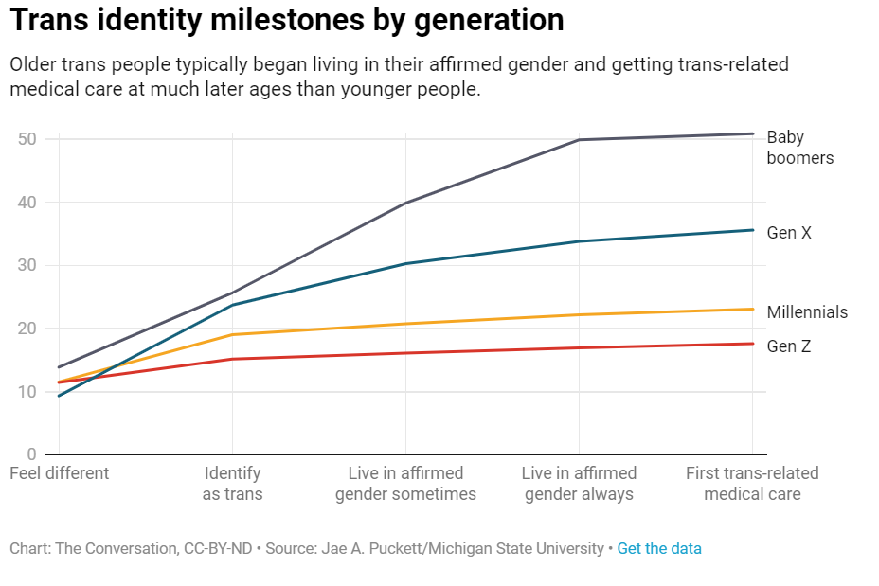

Slide 6
What is transition?
Social
Medical
Not all trans people transition in the same way, or at all!

Slide 7
Words and terms to be aware of
Transsexual (trans/transgender)
Transvestite (cross-dresser*)
Hermaphrodite* (intersex)
Homosexual (gay) and queer*
Born/natal male/female (sex assigned at birth)
“Preferred gender” (true/confirmed)
Gender reassignment surgery; pre-op/post-op (gender affirming or confirmation surgeries)
*Older people may have
different relationships and feelings about these words and terms
https://www.stonewall.org.uk/help-advice/faqs-and-glossary/glossary-terms
https://healthtalk.org/Experiences-of-trans-and-gender-diverse-young-people/Words-and-terms-explained
Notes:
Put links for Stonewall & Healthtalk glossaries in chat:
https://www.stonewall.org.uk/help-advice/faqs-and-glossary/glossary-terms
https://healthtalk.org/Experiences-of-trans-and-gender-diverse-young-people/Words-and-terms-explained
CAFAB, CAMAB (coercively assigned) female to female: all helpful in shifting the narrative from ‘changing from one gender to another’ to ‘expressing/being your true gender’ (vs ‘preferred’)
Here are some words and phrases which we urge you to avoid using because they’re outdated, offensive, inaccurate or a combination of these.
Transsexual: This term was used in the past as a more medical term to refer to someone who transitioned to live in the ‘opposite’ gender to the one assigned them at birth. It’s still used by some & being reclaimed although the terms ‘trans’ or ‘transgender’ is preferable.
Transvestite: sometimes still used to describe a person who dresses in clothes usually associated with the ‘opposite’ gender but the accepted description now is ‘cross-dresser’ – still problematic, as it implies a moral judgement & can reinforce stereotypes. A cross-dresser may not identify as trans.
Hermaphrodite: Considered outdated and offensive, the acceptable term is intersex.
Born/natal male/female: Uncritically puts genitalia viewed at birth as representing what someone is. Undermines the validity of a person’s gender identity if it’s at odds with birth assignment. A more accurate term is ‘sex assigned at birth’.
“Preferred gender” implies that gender identity is a choice, which it isn’t. For ‘preferred gender' use ‘confirmed’ or ‘true gender’.
Post-Op/Pre-Op: Offensive, intrusive; many trans people do not have surgery. There is more than one op, hence ‘surgeries’
Gender affirming/confirmation = not ‘changing/turning’, identity positions a person as M,F,NB, so surgery is affirming.
In surgical context: more specific language used, e.g. ‘genital reconstructive surgery’, ‘facial feminisation surgery’.
Eg. for trans women: vaginoplasty, breast implants, facial(above).
Trans men: phalloplasty, salpingo-oophorectomy (removal of fallopian tubes & ovaries), hysterectomy, mastectomy.
‘Top/bottom surgery’. Phono-surgery for trans women to raise voice pitch.
Are there any other terms you would you like to discuss?

Slide 8
The Dewis Choice Project is the first dedicated service in the UK for older men, women and non-binary people who’ve experienced domestic abuse from an intimate partner and/or adult family member.
They have a range of resources on their website including guidance for practitioners working with older victims, Dementia & Domestic Abuse and Supporting older LGBTQ+ Survivors.
This film is part of their work with older LGBTQ+ survivors
Do You See Me? - YouTube
About Us - Centre For Age Gender and Social Justice (dewischoice.org.uk)
The Dewis Choice Project

Slide 9
Older LGBTQ+ people and relationships
The primary focus of interest in gender and sexuality is often centred on younger people
There is a tendency to ‘desexualise’ older people
Older LGBTQ+ people are often overlooked in terms of improving understanding around their individual identities and their lived experiences of relationships in later life
The additional barriers older LGBTQ+ victim-survivors may face when accessing and engaging with services may not be recognised

Slide 10
Known research
There is a lack of recent research on the subject of Older LGBTQ+ people
In 2011, Stonewall commissioned a survey of people aged 55+ who identified as LGBTQ+
Older LGBTQ+ people are more likely to be single
More likely to live alone
Less likely to have children
Less likely to have contact with biological family
More likely to experience poor mental health

Slide 11
Available Data
Domestic abuse victimisation is under reported by LGBTQ+ people with between 60-80% of cases going underreported
According to SafeLives (2018) data, only 2.5% of all survivors accessing domestic abuse services in England and Wales identify as LGBTQ+
The Crime Survey for England & Wales age cap has hampered data collection but is removed from 2022

Slide 12
Stigmas & Assumptions
Society tends to think of LGBTQ+ people as being younger - This means some professionals will have the same view
Older people reported to Dewis Choice that they hid their sexuality from health and social care professionals fearing that it would affect their access to support, especially if they needed carers to come into their home
Older people have been the same sexuality/gender all their lives

Slide 13
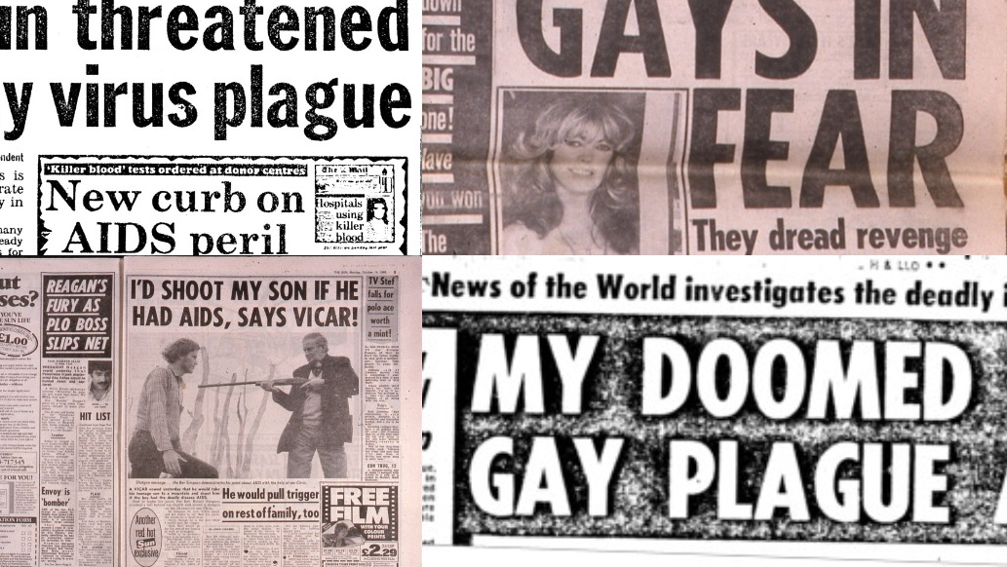

Slide 14
Myths
Domestic Abuse is about male violence – so people in lesbian relationships cannot experience domestic abuse
Men are all violent, so abuse in a gay relationship is expected
LGBTQ+ older people have had a tough life so can cope better with abuse of all kinds
An LGBTQ+ relationship isn’t serious, so it’s much easier for the victim to leave

Slide 15
Types of abuse & increased risk
Intimate relationships
Familial abuse – biological family or chosen family
Isolation – reduced social connections, excluded from LGBTQ+ spaces as they get older
LGBT people are at an increased risk of being a victim of crime compared to the general population of the United Kingdom, including victimisation through domestic violence and abuse
Being hidden from services
Risk assessments, such as the DASH RIC, are based on heterosexual relationships
More likely to self-blame
For trans people, additional/unique forms of abuse incl.:
Co-incidence with adverse childhood experiences (ACE)
Exacerbating effect on other MH needs

Slide 16
Methods of abuse
Older LGBTQ+ people experience many of the same types of abusive behaviours as heterosexual, cis-gendered people,
They can also experience abuse targeted specifically at their sexuality and gender identity, including:
Controlling someone by threatening to “out” them
Manipulating an older LGBTQ+ partners lack of relationship experience to create a false sense of what is acceptable
Purposely using the wrong pronouns, undermining, attacking, or denying identity as an LGBTQ person;
Claiming a person is not a real lesbian or gay man;
Threatening to reveal a person’s HIV or AIDS status;
For trans people, additional/unique forms of abuse incl.:
Deliberate, incorrect pronouns usage
Preventing medical transition through intervention or gatekeeping
Use of someone’s trans/NB identity in other tactics of abuse

Slide 17
Barriers to seeking support
Assuming services cannot address needs of LGBTQ+ people, especially if they are older survivors
Advertising featuring young, heterosexual people
Lack of specialist LGBTQ+ abuse support services
Historical distrust of police and statutory services
Fear of exposing LGBTQ+ relationships as negative

Slide 18
Making it easier to get support
Ask!
Avoid gendered language such as husband/wife until you have established sexuality
Don’t assume someone is ‘out’ in all areas of their life
Identify positive relationships as well as harmful ones
Person-Centred approach
Don’t assume it’s easier or less risk to leave a LGBTQ+ relationship than a heterosexual one

Slide 19
Signposting
Galop National LGBTQ+ abuse charity www.galop.org.uk
Hourglass – National elder abuse charity www.wearehourglass.org
Stonewall: National LGBTQ+ charity: www.stonewall.org.uk/
Gendered Intelligence: Trans-led charity, supporting youth and adults: https://genderedintelligence.co.uk/
Diamonds: Cambridge-based trans/NB support: http://www.diamondstgc.org.uk/
Encompass Network: LGBTQ+ charity in Cambridgeshire: http://encompassnetwork.org.uk/

Slide 20
Further Reading
Older LGBTQ+ People
Blog - Support for LGBTQ+ people in later life
Information Hub - Age UK's section on LGBT+ rights
Age UK’s Guide, ‘Safe To Be Me’
Age UK Factsheet on Trans Issues and later life
Best Practice - Stonewall Report/Guidance on working with older LGB people.
LGBT Ageing Centre’s Best Practice for inclusive services
Webinar: How To Be An Ally to Transgender Older Adults (2021)
Trans/NB experiences of Domestic Violence
Safe Lives Transgender Survivors Report
Scottish Transgender Alliance Report on Domestic Abuse
The Gender Recognition Act
Stonewall summary of UK’ government’s response to the GRA
Advice on trans inclusion in workplaces (including toilets and changing facilities)
Brighton and Hove Trans Inclusion Toolkit (2021)
Hate Crime
Crown Prosecution Service guidance on HBT crime
BBC reporting on the rise in transphobic attacks

Slide 21
Any Questions?

