Slide 1

Children and Young Persons Independent Sexual Violence Advocate
(ChISVA)
Amelia Taverna
Phoebe Deidda
Vicky Olik

Slide 2
Learning objectives
To understand
What a CHISVA is
What our role is withing the CJS
What else we can do to help

Slide 3

What is a chisva?
Children and young persons Independent Sexual Violence Advocate
Client led
Emotional Support
Advocacy
Criminal Justice

Slide 4

What do we offer?
Under 19s work with young person or indirect with parent
Emotional support
Signposting/referring
Support through Criminal Justice Process -
Advocacy – school, social care, ensure other professionals hear the voice of the child

Slide 5
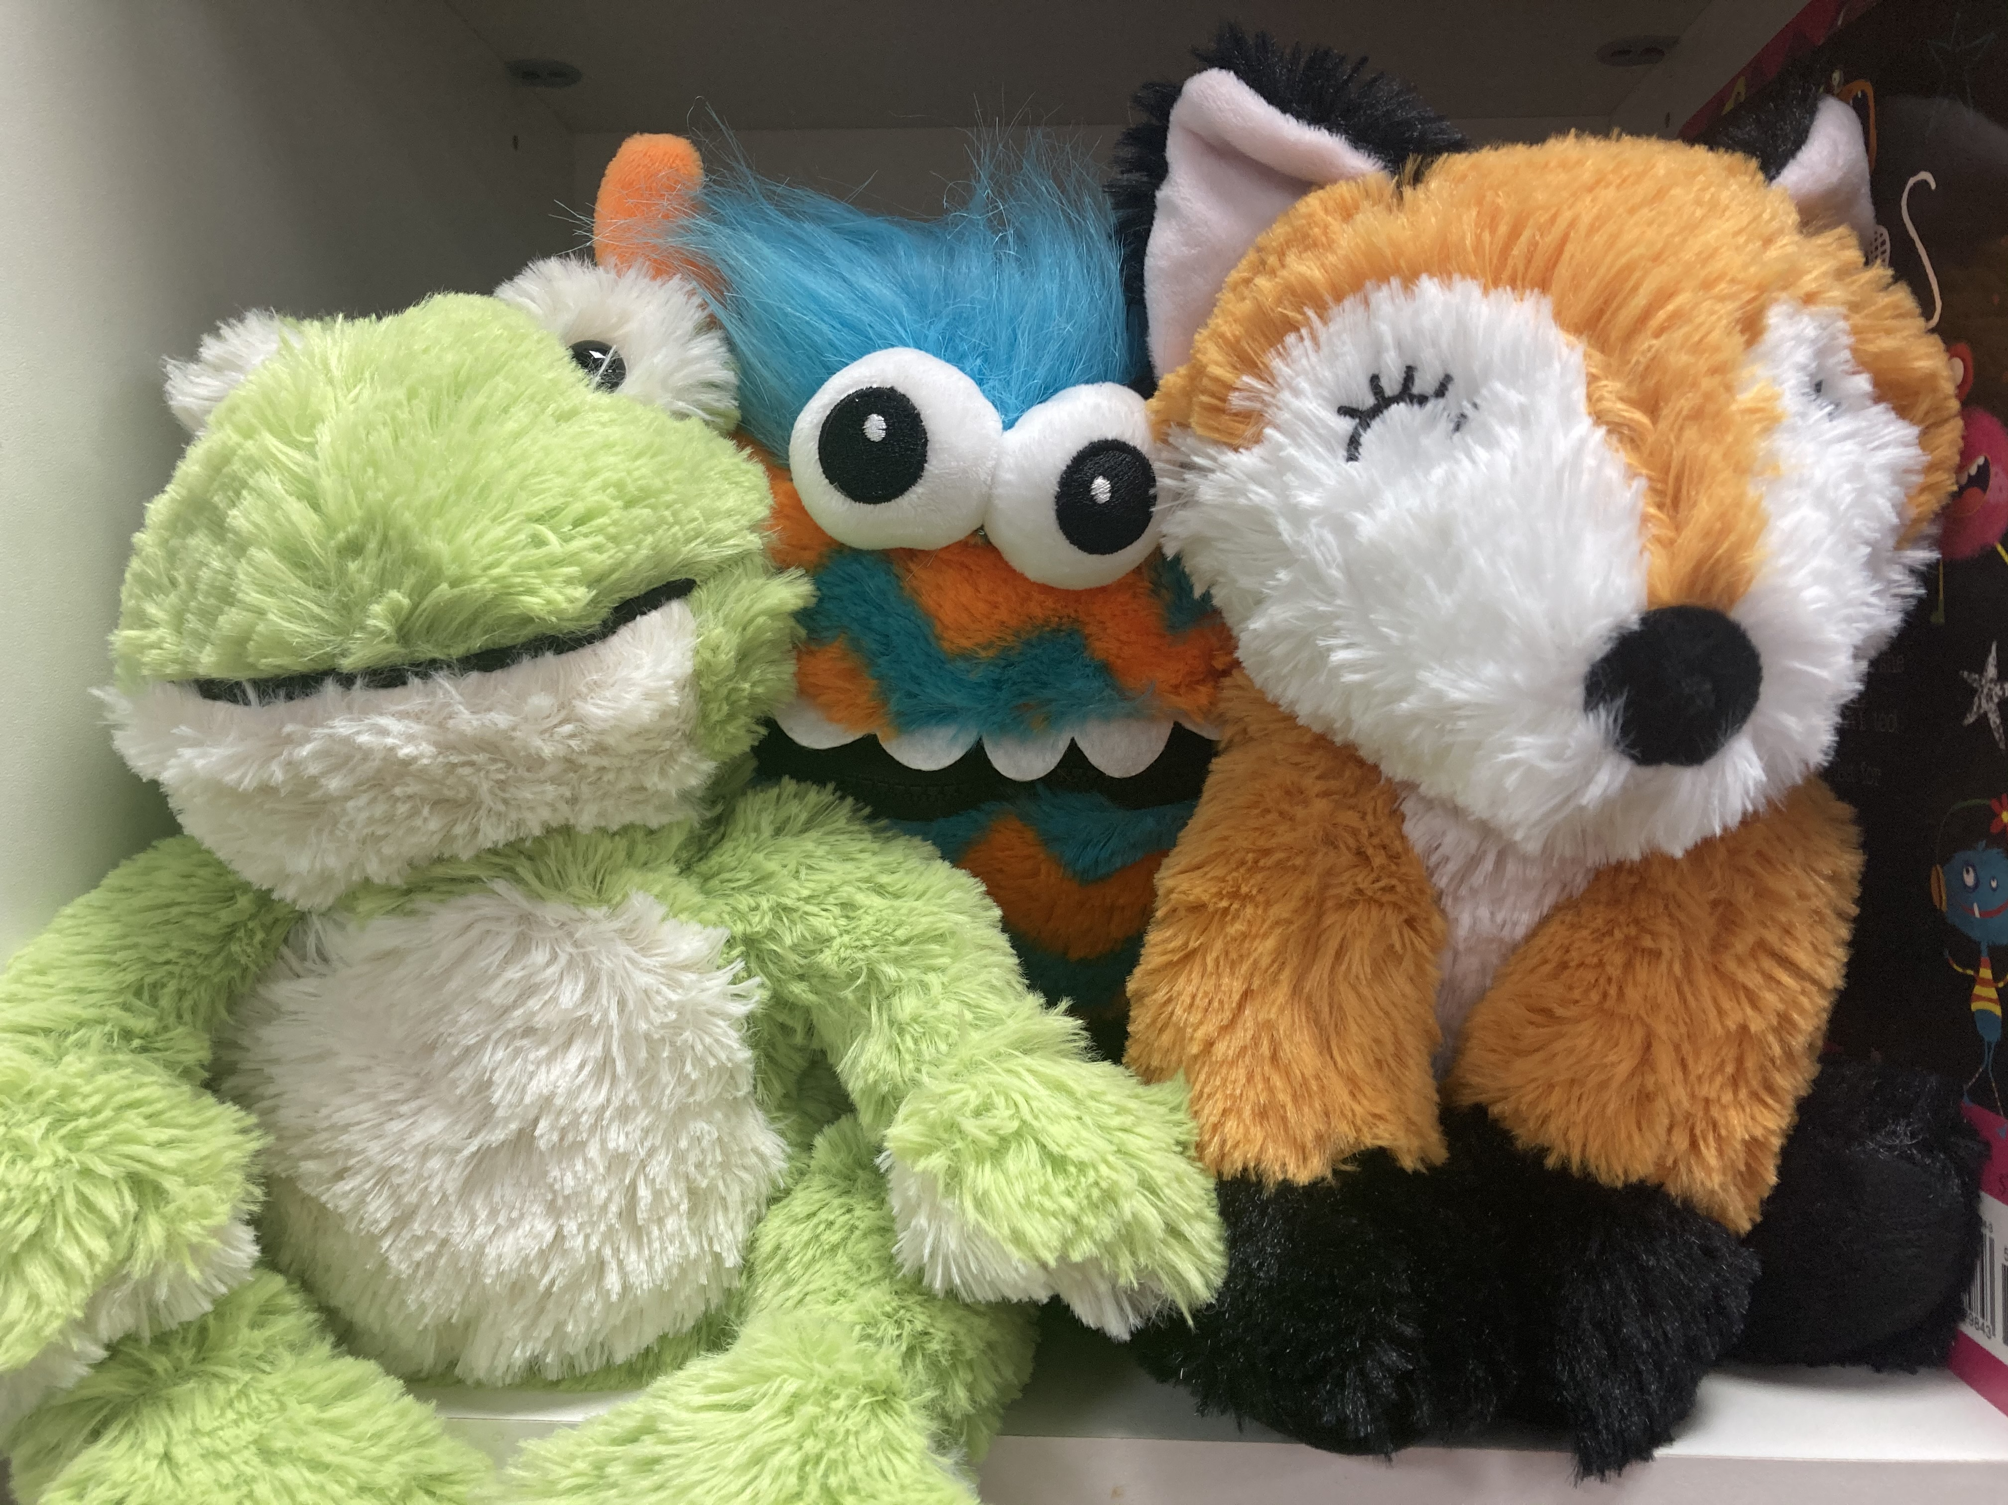
Under 11s working with primary age and younger
Tailored support depending on needs
Direct client led support for children over 6
Referral to specialist support (Embrace, TRCIC/Play therapy)
Limited sessions if the child wants to talk about the impact and/or questions on criminal justice process
Rapport building if ChISVA supporting young person giving evidence

Slide 6
Higher or lower?

Slide 7
Higher or lower?
HIGHER
1 in 4 females have been subjected to some kind of sexual violence
LOWER
Only 3% of sexual violence reports are found to be false
HIGHER
1 in 6 children have been subjected to childhood sexual abuse
HIGHER
9 in 10 girls in school have been called sexist names or sent dick pics/sexual images
72% of adults who experienced abuse before the age of 16 also experienced domestic abuse in adulthood
6 out of 10 girls in school have been called sexist names or sent dick pics/sexual images
LOWER
52% of adults who experienced abuse before the age of 16 also experienced domestic abuse in adulthood
HIGHER
7 out of 8 don’t come to the attention of police or authorities
1 in 10 children have been subjected to childhood sexual abuse
Half of all children experiencing sexual abuse don’t come to the attention of the authorities
1 in 10 females have been subjected to some kind of sexual violence
8% of sexual violence reports are found to be false

Slide 8

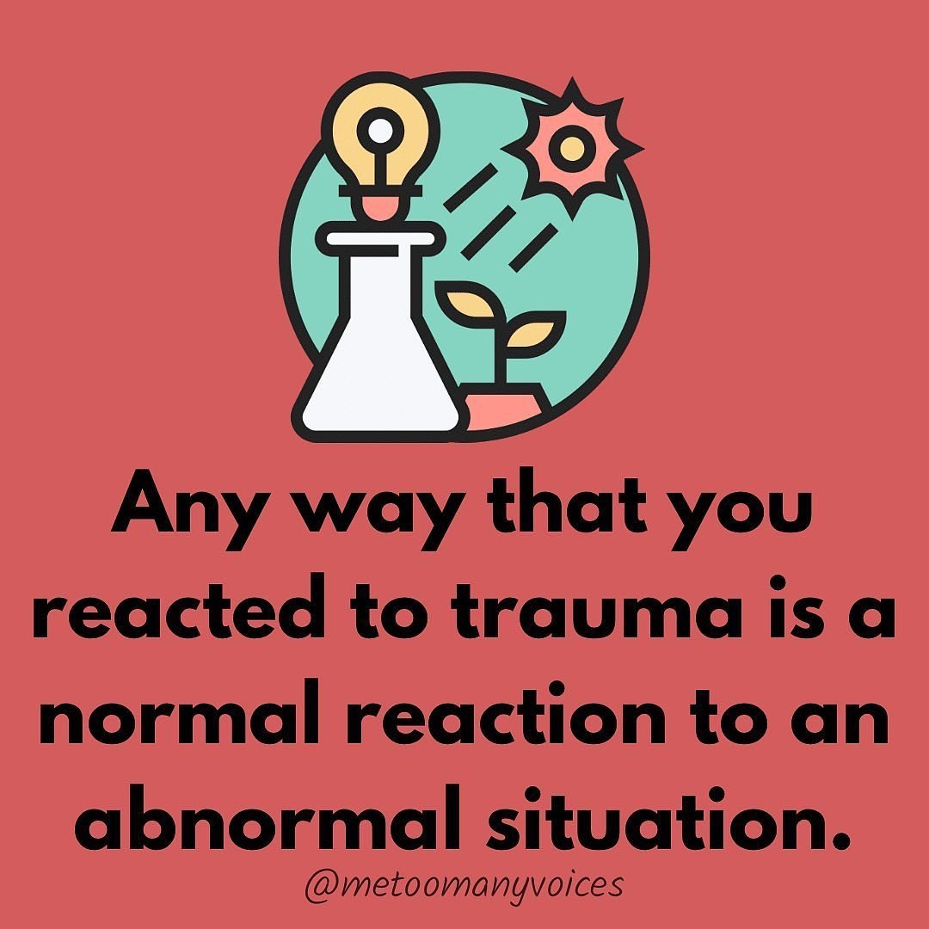
Impact of sexual violence
Behavioural Reactions
Emotional Reactions
Physical Reactions

Slide 9
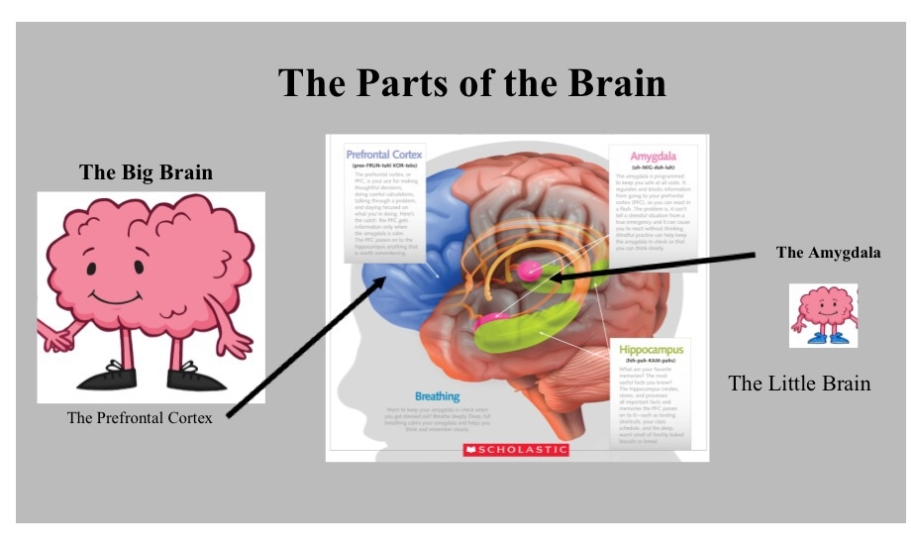
Fight flight freeze flop
Friend

Slide 10

Self harm is for coping
High prevalence of self harm, suicidal ideation in our client group
Self harm can be to calm
Self harm is not a straight line to a suicide attempt
What does the young person want us to do?

Slide 11
Resources https://www.youtube.com/watch?v=1fp2D7jSFA8
Notes:
AT video using resources

Slide 12
Supporting a survivor
Listen and let them say what they need to in their own words and in their own time.
Believe what they tell you
Offer unconditional support
Remain patient
Recognise that they might feel guilty
Explore their options with them
Empower them
Be aware of your language
Survivors are the experts in their own healing
Explore and challenge own views

Slide 13

Myths and facts

Slide 14

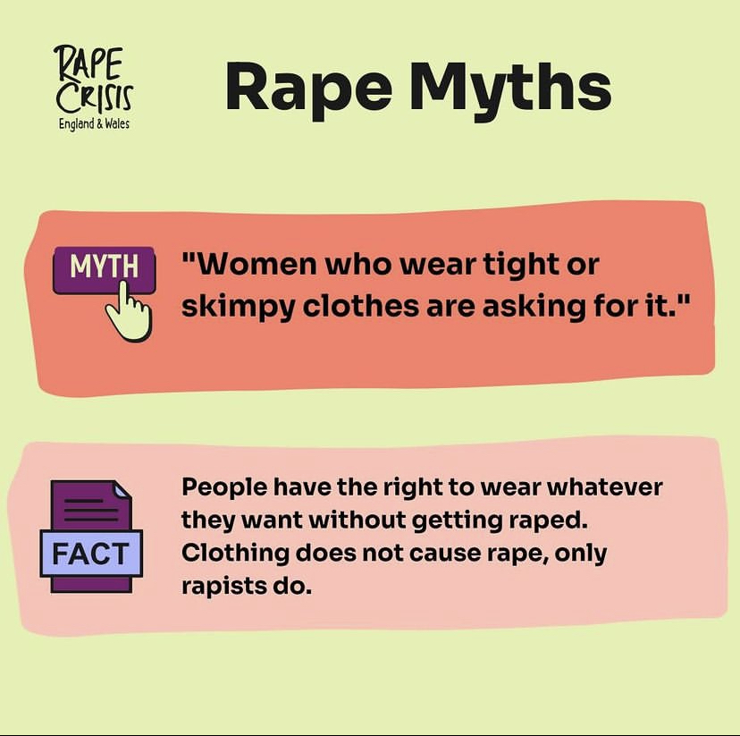
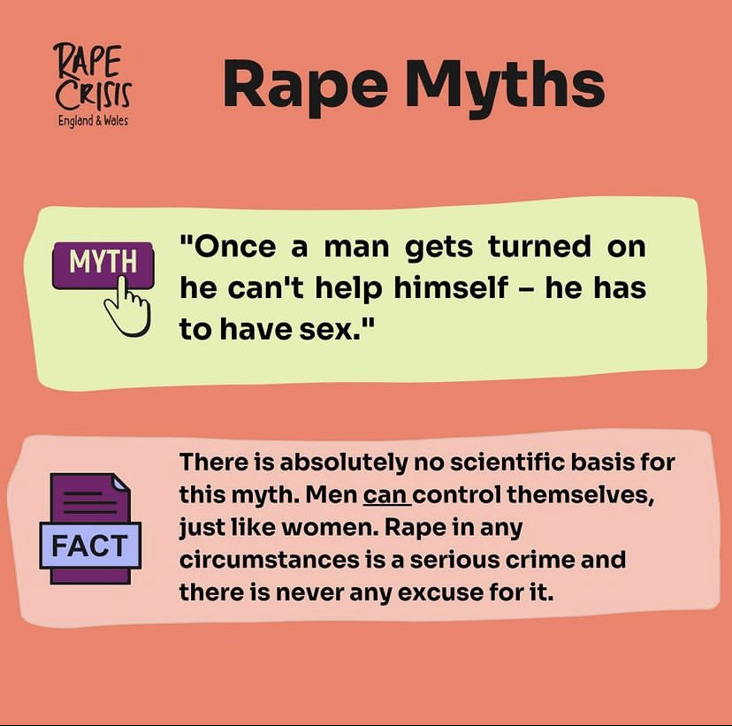


Slide 15





Slide 16
Criminal justice
Informed Choices
Initial report
ABE
Investigation
NFA
Charge
S28
Trial
VRR
CPS Review
Sentence
Not Guilty verdict
Sentence
No report
VRR upheld
Police Review
Police review
NFA
Plea Hearing
No VRR
Back to police
ABE/VRI: Achieving Best Evidence / Video Recorded Interview
NFA: No Further Action
CPS: Crown Prosecution Service
VRR: Victims Right to Review
S28: Section 28 (pre recorded evidence in chief)

Slide 17
Criminal justice key points
Informed choices
abe
investigation
nfa
Court
Give back power and control
Emotional Support
Grounding
Survivor contact through lengthy process
ChISVA and Police attend together
Victims Right to Review
Special Measures?
ChISVA attend

Slide 18



Schools’ response to sexual violence
disclosure
safeguarding
investigation
listen
guidance
Be clear with confidentiality
Involve survivor
Don’t panic!
What arrangements are in place for the survivor?
On the balance of probabilities
The survivor’s voice should be heard
KCSIE
HRA
DOE

Slide 19
Case studies
Under 11 survivor: Investigation resulting in NFA
Notes:
AT

Slide 20
Case studies
Teen survivor: Guilty verdict at court

Slide 21
Notes:
VO

Slide 22
Referral process
Referer completes referral through our website https://www.prccg.org.uk/referral-forms/
Duty ISVA receives referral
Duty ISVA makes contact with survivor to carry out initial assessment
Survivor allocated to relevant support
ChISVA makes contact with survivor/parent
Notes:
VO

Slide 23






THANK YOU, any questions?
amelia@prccg.org.uk
phoebe@prccg.org.uk
vicky@prccg.org.uk
Make a referral on our website:
www.prccg.org.uk/referral-forms/

