Slide 1
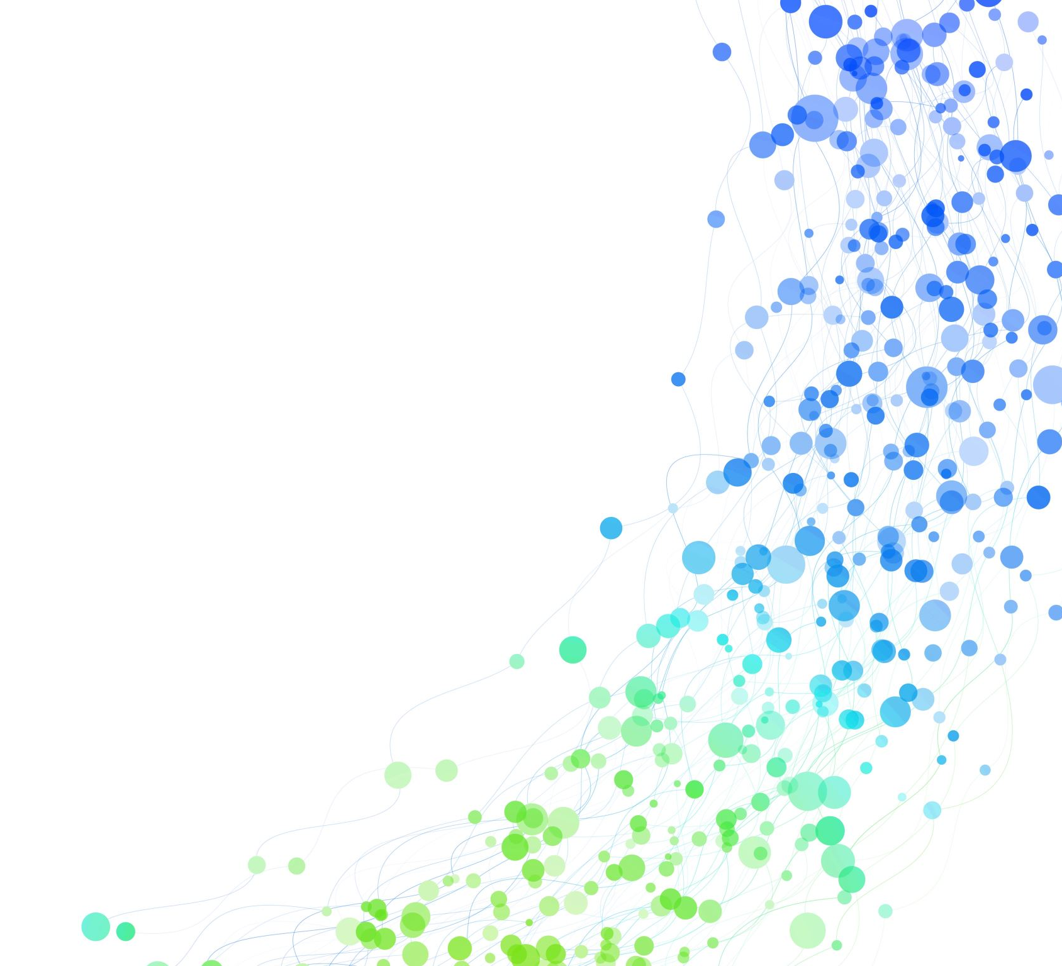
Unpaid Carers and Domestic Abuse
Amanda Warburton (DASVP)
Miriam Martin (Caring Together)

Slide 2
What is a Carer?
‘someone who helps another person, usually a relative or friend, in their day-to-day life.’
UK Government (2014)
Notes:
CT The person cannot cope with daily living activities without their help

Slide 3
How many people are Carers?
1 in 5 (Carer’s UK 2022)
58% of Carers are female
35 hours per week caring to claim Carers Allowance
Notes:
CT £76.75 – however many people you care for, cared for must get certain benefits, earning £139 or less pw, only one carer can claim, can’t get full CA and state pension

Slide 4
Carers Trust say that many carers do not identify as such;
they see themselves as wife, husband, child, parent or family member and wouldn’t use the term ‘carer’ to describe themselves
Notes:
CT Also consider what the cared for person wants – do they want a carer or do they want them to just be wife, husband, child etc?

Slide 5
Reasons people need care:
Physical health
Learning Disability
Mental Health (including Dementia)
Substance addiction
Notes:
CT

Slide 6
What might a Carer do?
Personal care
Cooking
Finance/benefits
Shopping
Collecting/administering medication
Caring for more than one person?
Anything else?
Notes:
CT Ask attendees to think of any other tasks carers might undertake (Taking to health appointments, companionship, emotional support, socialising, maintain safety)

Slide 7
What is Domestic Abuse?
behaviour consisting of any of the following: physical or sexual abuse;
violent or threatening behaviour;
controlling or coercive behaviour;
economic abuse
psychological, emotional, or other abuse
…between persons that are ‘personally connected’. The definition of personally connected includes partners, ex-partners and relatives
(Domestic Abuse Act 2021)
Notes:
AW Hitting, pinching, kicking (don’t assumed can’t be physical because of disability), Control (attending appts, preventing getting other carers, can’t make decisions alone), Economic (LPA, benefits, preventing spending on other carers), Psychological (gaslighting, threats if ask for support, you’ll go in a home etc)

Slide 8
Domestic Homicide Review data
Thematic Review of Domestic Homicide Reviews from Oct 20-Sept 21 (Home Office 2023)
In 10 of these, the carer was the perpetrator – none had received a carers assessment
The carer was the victim in 12 cases - Only 1 victim had a Carers Assessment
Notes:
AW Total 108 Don’t know if were offered a carers assessment

Slide 9
Domestic Homicide – risks highlighted in DHRs
Mental Health issues (Carer or Cared for)
Substance addiction
Previous abuse not considered
Suitability and capacity to take on Carer role
Notes:
AW

Slide 10
Carers as Victims of Domestic Abuse
Abuse may have been ongoing for a long time or may be as a result of illness
Carers can be isolated – restrictions on time away from the home or visits from friends/family – may have to give up work
Feeling controlled into providing care, feeling trapped
Losing their own identity
Worried about consequences if they ask for help
Notes:
AW

Slide 11
Risks to Carers
Close proximity of personal care – physical violence, sexual abuse
Emotional abuse and control – feeling they can’t leave
Isolation
Notes:
AW - DASH may not represent these risks

Slide 12
Consequences of speaking out
Guilt, especially if the abuse is as a result of illness
Other people thinking they can’t cope
Cultural expectations
Will cared for person have to go into a home or have carers who are strangers?
Notes:
CT

Slide 13
Support for Carers?
Carer Assessment – 25% assessed or re-assessed in the last 12 months (Carers UK State of Caring 2022)
GP Carer register – should signpost to carer support services and link records but not consistent
Carers Surveys
None ask about domestic abuse
Notes:
CT

Slide 14
Care or control?
Does the cared for person want the family member to be their carer? Does the carer want to be a carer for that person?
Remember unpaid carers don’t receive any training!
A carer may do things differently to how a professional may advise – not necessarily abuse
Actions of a carer may be due to frustration, need to complete care tasks, caring for more than one person – who has the power?
Notes:
CT 3) In which case social care can support with options and involve other agencies. 4) joint decision making

Slide 15
Carers as deliberate abusers
Abuse is about power and control over another person – caring provides this opportunity for people who choose to abuse
Little professional curiosity if cared for person seems well
Assessments or appointments done with Carer present
Tables turning
Notes:
AW

Slide 16
Risks to Cared For Person
Personal care – physical and sexual abuse
Control and isolation
Physical abuse disguised as accidental
Economic abuse (inc LPA abuse)
Notes:
AW

Slide 17
Consequences of speaking out
Carers who are strangers
Moving to residential care
Family fallouts
Cost of other options
Notes:
AW

Slide 18
The role of Adult Safeguarding
Adults with Care and Support Needs who cannot protect themselves, risk
Most Unpaid Carers have support needs but don’t meet criteria
If you feel they do, give enough information
Notes:
AW

Slide 19
What you can do – organisation level
Include questions or information about DA in Carers Assessments, Carer Surveys – ask separately
Include DA in Carer Strategies, carers policies and standard operating procedures
Specific training around DA and Carers – not subsumed into ‘Safeguarding’
Notes:
AW

Slide 20
What you can do - frontline
Ask about DA – with each person separately
Be specific, explain what DA might look like
Adapt safety planning
Signpost to support
Notes:
AW Think about meeting in different ways

Slide 21
Case study 1
Carer is caring for her husband who has alzheimers. His condition has progressed and he has become violent. Prior to his diagnosis they had a good loving relationship.
Carer is providing support with all aspects of care, personal care, meals, support with medication, shopping.
A number of incidents have occurred, most recently he threatened to ‘plant a hammer in her head’ which made her very frightened and she locked herself in her bathroom. On another occasion he grabbed her by the jumper, he also picked up a glass to throw at her but she managed to knock it out of his hand.
The police had been called when she had locked herself in the bathroom and they advised they could not take him into custody due to the alzhiemers diagnosis. An ambulance was called which arrived 12 hours later. They also advised that as this was due to his mental health and there was nothing physically wrong with him they could not take him into hospital.
She had previously refused any help but is now realising that she can not go on like it is. There is no family support as their daughter lives 400 miles away.
The carer does not feel able to leave him with anyone else as she is worried that he will also be violent with them but she has found he is tending to take all his anger out on her.
Notes:
CT

Slide 22
Outcomes of Unpaid Carers/DA project
Carers as victims of domestic abuse added to revised countywide Carer’s Strategy
DA awareness added to Home Care Contracts
Anonymous carer survey open until early Sept https://www.smartsurvey.co.uk/s/WVCYQY/
Guidance for professionals available at Cambridgeshire County Council DASV Partnership - Guidance for Professionals (cambsdasv.org.uk)
Contacts
Caring Together - 0345 241 0954 and you can also email us on hello@caringtogether.org
Referral form also available at www.caringtogether.org
Notes:
CT

