Slide 2
DASS – Domestic Abuse Support Service
Overview
For Cambridgeshire and Peterborough
Presented by
Charley White
DA Manager
D.A.S.S
Domestic Abuse Support Service

Slide 3
What we are going to achieve
Increased feeling of safety
Individuals and their children are safer and better resourced to remain safe.
Individuals retain/regain sense of autonomy and control.
Individuals and their children have strong and resilient support networks.
Individuals believe they can live free from violence and abuse.
Risk Assessments are carried out and risks are managed.
D.A.S.S
Domestic Abuse Support Service

Slide 4
What we are going to achieve
Improved Health and Wellbeing
Individuals develop increased resilience and resources to prevent further experiences of violence.
Individuals have improved mental and emotional health and resources to maintain good mental and emotional health.
Individuals have improved physical health and resources to maintain good physical health.
Individuals have enhanced sense of agency around sex and relationships.
D.A.S.S
Domestic Abuse Support Service

Slide 5
What we are going to achieve
Better able to cope with everyday life
Individuals have increased financial stability and independence.
Individuals live in stable and secure accommodation.
.
D.A.S.S
Domestic Abuse Support Service

Slide 6
What we are going to achieve
Better informed and empowered to act
Advice, advocacy and liaison.
Emotional support, counselling and advice.
Help finding or retaining accommodation.
Help in establishing personal safety and security.
Help in managing finances and benefit claims.
Signposting and support with health services.
Signposting to legal services.
.
D.A.S.S
Domestic Abuse Support Service

Slide 7
Support Offered
Assess individual needs and wishes in a Trauma Informed Way.
Assess financial capability and assist with benefits.
Develop appropriate support and safety plans.
Source accommodation suited to the families financial means;
safety needs and individual requirements.
Signpost to specialist support (Legal/ Mental Health/ Drug & Alcohol) where required.
Support to set up utilities, source and purchase furnishings, white goods and other essential items.
D.A.S.S
Domestic Abuse Support Service

Slide 8
Email DASSreferrals@impakt.org.uk
Tel. 01234 264109
Contact us

Slide 9
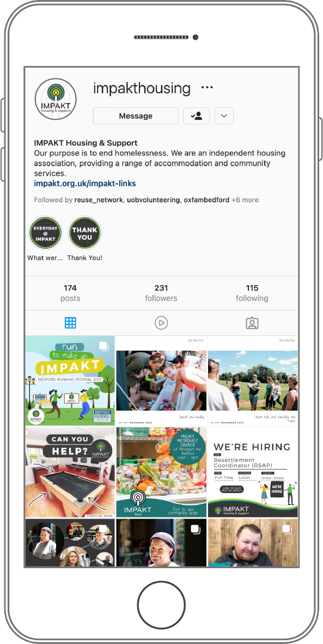
FIND US ON SOCIAL MEDIA
DONATE, VOLUNTEER, & FIND OUT MORE ON OUR WEBISTE
www.impakt.org.uk
More Information

