Slide 1
Domestic Homicide Reviews
Vickie Crompton
Domestic Abuse & Sexual Violence Partnership
June 2022

Slide 2
What is a Domestic Homicide Review?
As of April 2011 there is a statutory requirement for Community Safety Partnerships to commission independent domestic homicide reviews as part of the Domestic Violence, Crimes and Victims act of 2004
Domestic homicide review’s are multi-agency reviews into the deaths of adults which may have resulted from violence, abuse, or neglect; by a person to whom they were related or with whom they had an intimate relationship, or where they were a member of the same household.

Slide 3
What is the Purpose of a Domestic Homicide Review?
Their purpose is to establish, identify and apply the lessons to the way local professionals and organisations work individually and together to safeguard victims to improve service responses, policies and procedures.
The rationale for conducting a DHR is set in the aim of ensuring agencies are responding appropriately to victims of domestic abuse by having effective and robust support mechanisms, procedures, resources, and interventions in place to prevent future incidents of domestic abuse and homicide.

Slide 4
Why are DHRs carried out?
A DHR should be carried out to:
Establish what lessons are to be learned from the domestic homicide regarding the way in which local professionals and organisations work individually and together to safeguard victims;
Identify clearly what those lessons are both within and between agencies, how and within what timescales they will be acted on, and what is expected to change as a result;
Apply these lessons to service responses including changes to policies and procedures as appropriate;
Prevent domestic violence homicide and improve service responses for all domestic violence victims and their children through improved intra and inter-agency working.

Slide 5
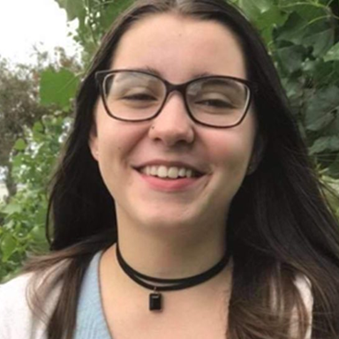
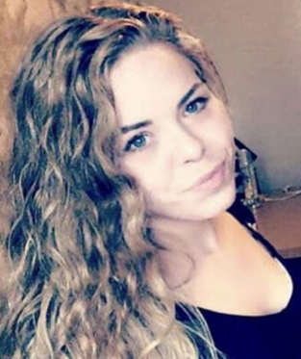
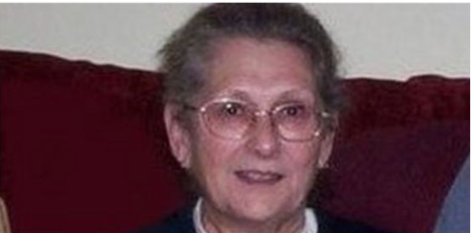
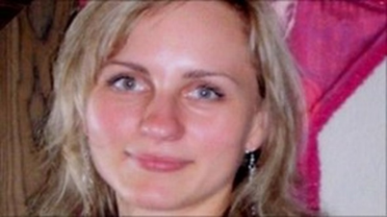
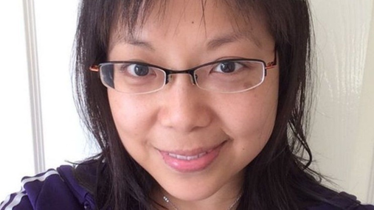
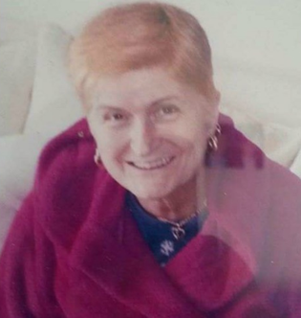
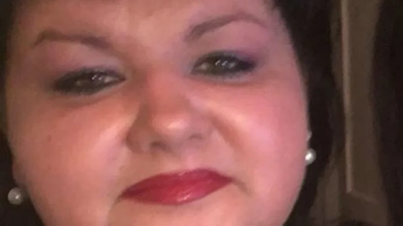
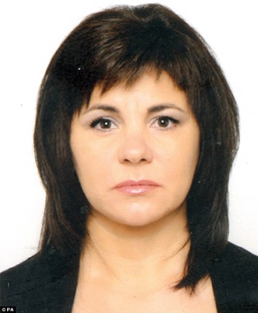
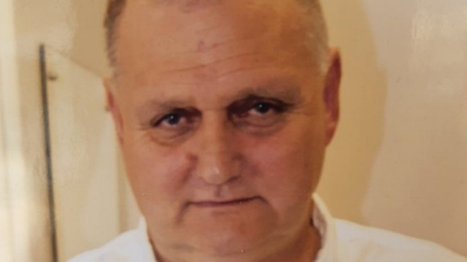
Who?

Slide 6
Summaries – A Snap Shot
Husband kills wife during mental health crisis
Man murders his female partner, he is also her carer
Man suffocates his wife who was 3 weeks postpartum
Woman kills her partner whilst he attacks her
Man drowns ex-partner in a ditch
Son kills his mum during mental health crisis
Man strangles his female partner
Wife and lodger kill husband by beating
Husband kills wife by stabbing and injures nephew
Man takes his own life following abuse by ex partner
Man kills 17 yr old step daughter – he body is still missing

Slide 7
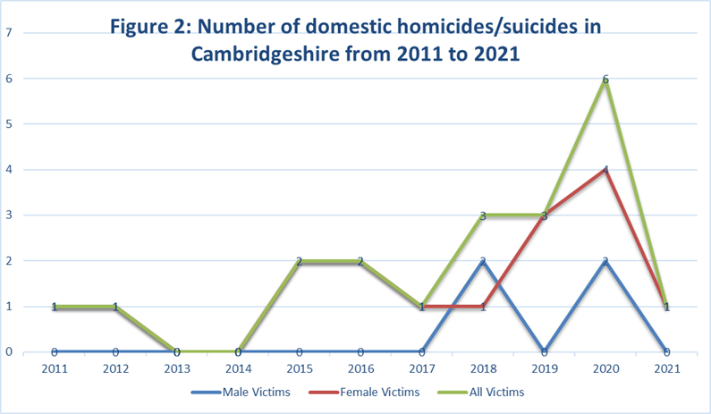
DHRs - Cambridgeshire and Peterborough
Between 2011 and 2021, 20 domestic homicide reviews.
12 have been published, 6 are with the Home Office and 2 are in the progress of being written.

Slide 8
In Cambridgeshire and Peterborough, 15 of the 20 DHRs are cases of domestic homicide, and the remaining 5 are cases of suicide relating to domestic abuse.

Slide 9
Domestic Homicides Demographics

Slide 10
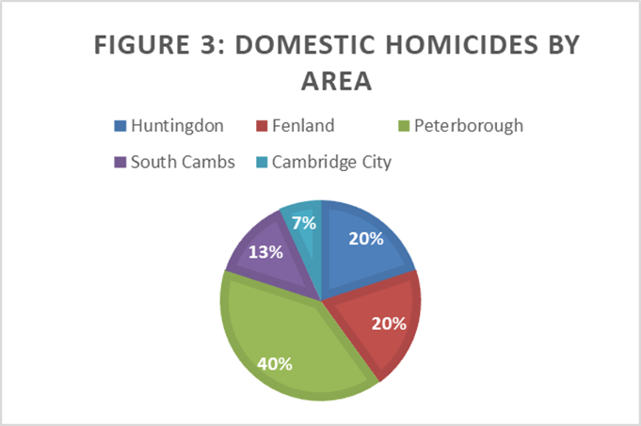
In Cambridgeshire and Peterborough, of the 15 domestic homicides, 6 were in Peterborough, 3 were in Fenland, 3 were in Huntingdonshire, 2 were in South Cambs and 1 was in Cambridge City.

Slide 11
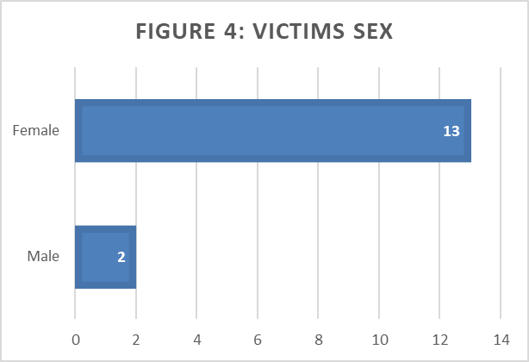
13 victims were female, and 2 were male - this translates to 86.6% of victims being female.

Slide 12
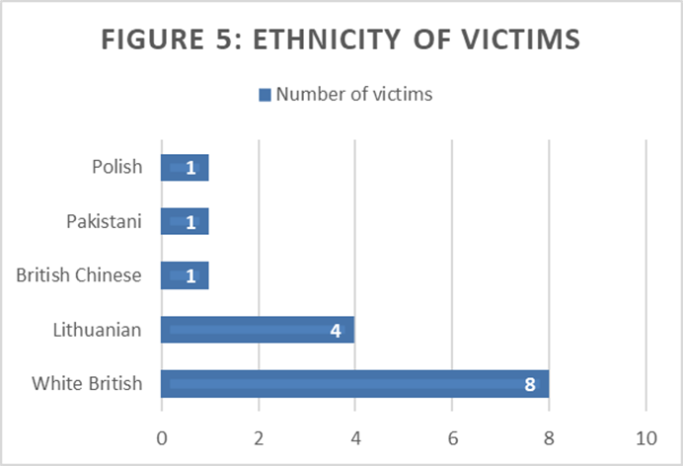
8 victims were White British, 4 were Lithuanian, 1 were British Chinese, 1 was of Pakistani ethnicity and 1 was of Polish ethnicity.

Slide 13
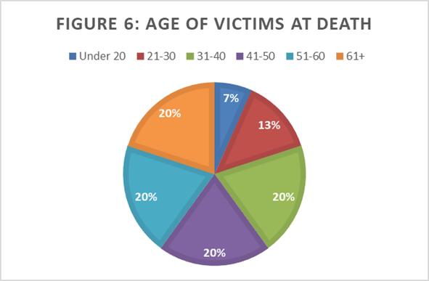
The average age of victims was 45.
There were 3 victims each in the 31-40 age category, the 41-50 age category, the 51-60 category and the 61+ category.
There were 2 victims in the 21-30 category and 1 victim was under 20.

Slide 14
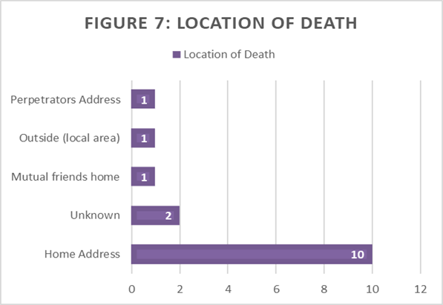
The most common location of death was at the home address of the victim (10 cases).
The perpetrators address (1 case), outside (1 case) and mutual friends house (1 case) were also known locations of death.
In 2 cases, the location of death was unknown.

Slide 15
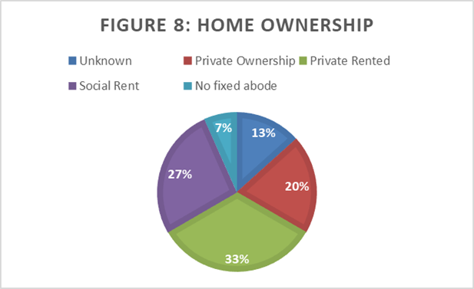
33% (5) of victims lived in a privately rented home, 27% (4) lived in social rented housing and 20% (3) lived in privately owned homes.
7% (1) had no fixed abode and in 13% (2) of cases the home situation was unknown.

Slide 16
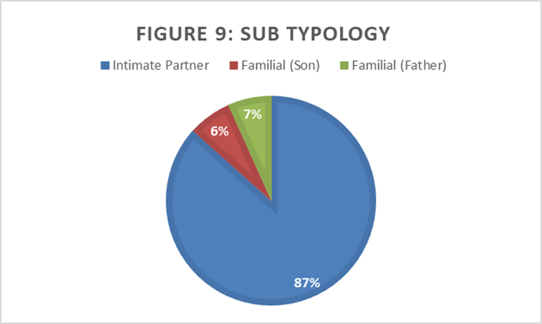
Sub typology refers to the specific type of domestic homicide that occurred.
In Cambridgeshire and Peterborough, 87% (13) of the cases were intimate partner homicides.
The other 13% (2) were familial, one where the perpetrator was the son of the victim and one were the victim was the perpetrator father.

Slide 17
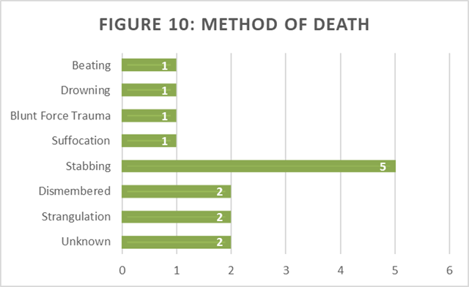
The most common method of death was stabbing (5 cases). After this, dismembering (2 cases) and strangulation (2 cases) were the most common.
Beating (1 case), drowning (1 case), blunt force trauma (1 case) and suffocation (1 case) were all methods of death too.
In 2 cases the method of death is unknown.

Slide 18
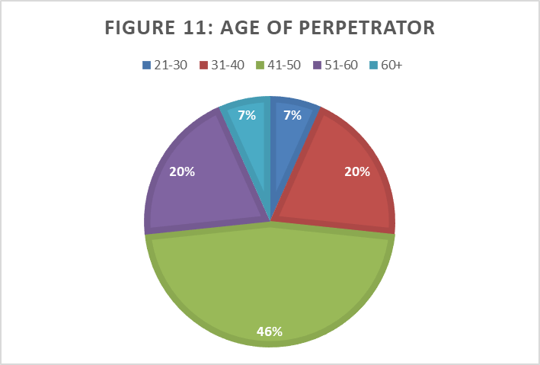
The average age of the perpetrators was the same as that of victims; 45 years old.
1 perpetrator was 21-30, 3 perpetrators were 31-40, 7 perpetrators were 41-50, 3 perpetrators were 51-60 and 1 perpetrator was 60+.

Slide 19
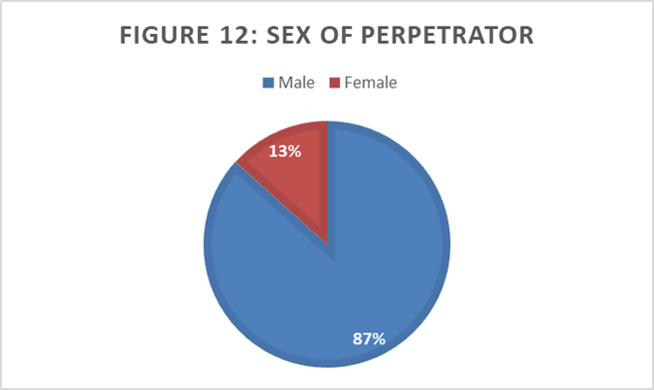
87% of perpetrators (13) were male, and 13% (2) were female.
However in one of these cases, the female perpetrator was also known to be a victim of domestic abuse.

Slide 20
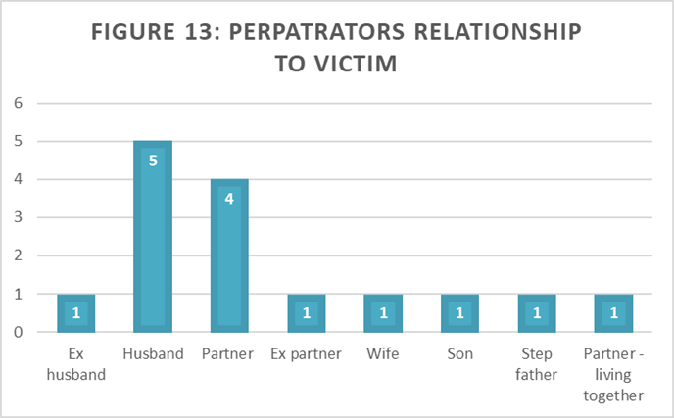
In 5 out of 15 cases of domestic homicide, the perpetrator was the husband.
The second most common relationship was partner (4 cases).
For the remaining 6 victims, the relationship with the perpetrator was; ex husband, ex partner, wife, son, step-father and partner (living together).

Slide 21
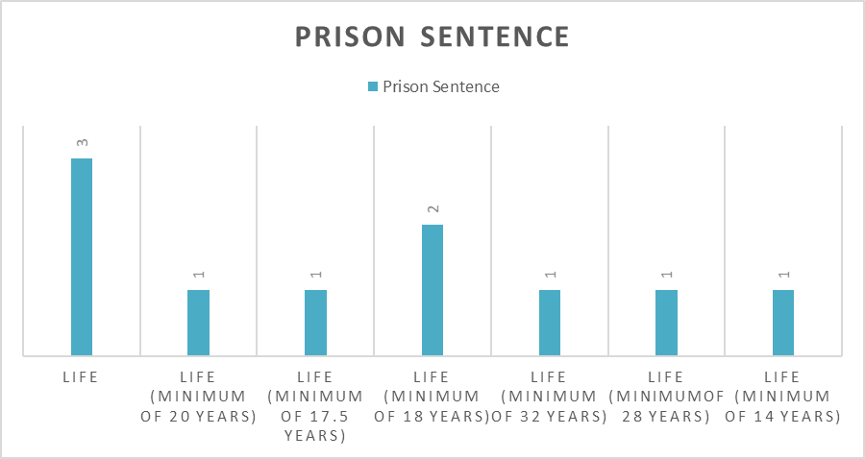
Of the 15 cases of domestic homicide, 11 perpetrators were convicted of murder.
A further 3 were convicted of manslaughter due to diminished responsibility, and in one case the perpetrator was not charged as it was regarded as self-defence.

Slide 22
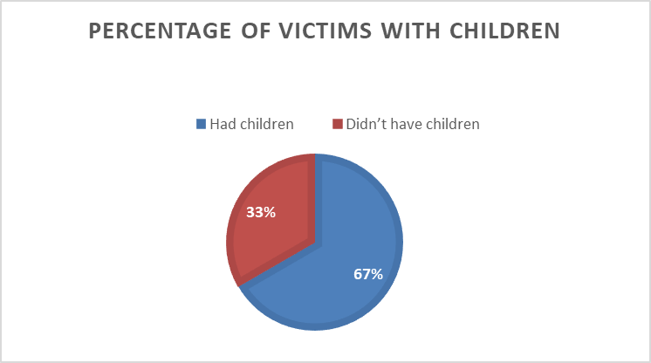
Of the 15 victims of domestic homicides, 10 were parents.
Of the 10 parents, 5 had children who were under the age of 18.
In one of the cases, a victim had given birth just 3 weeks prior to their homicide.

Slide 23
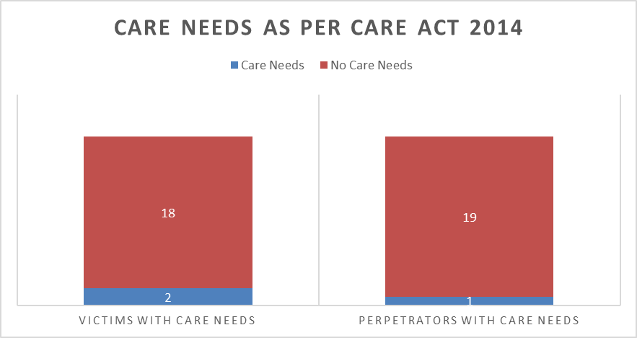
In Cambridgeshire, looking at both domestic homicides and suicides, 2 of the 20 victims had care and support needs under the Care Act 2014.
Of the perpetrators, one was known to have care needs, but in this case (domestic abuse related suicide) the victim was known to also be the perpetrator of domestic abuse.

Slide 24
Domestic Abuse Related Suicide Demographics

Slide 25
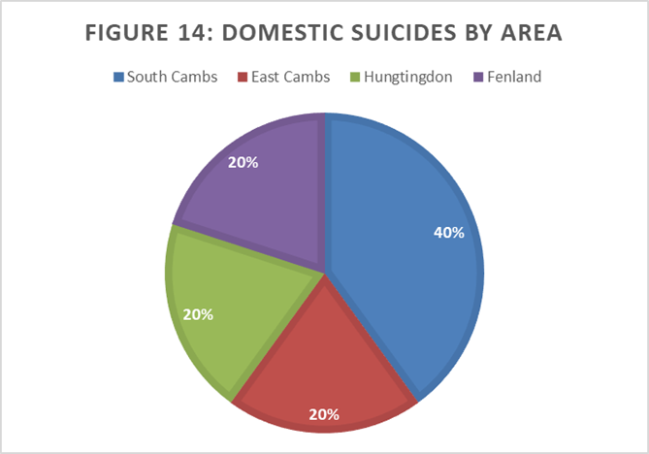
As seen in Figure 14, South Cambridgeshire accounts for 40% of domestic abuse related suicides (2 out of 5 cases).
East Cambridgeshire, Huntingdon, and Fenland have each had 1 domestic abuse related suicide.
Both Peterborough and Cambridge City have no domestic abuse related suicides in this time period.

Slide 26
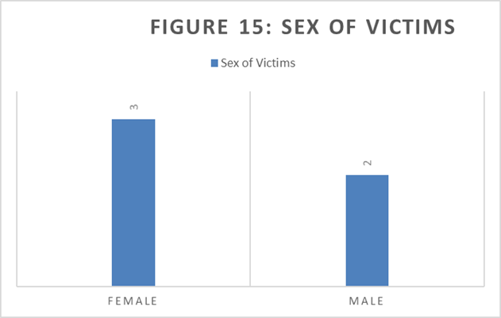
Of the 5 cases of domestic abuse related suicides in the county, 3 victims were female, and 2 were male. This presents a significantly more even gender split than that of domestic homicides.

Slide 27
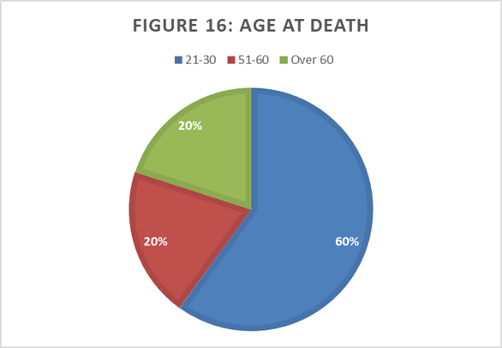
As seen in Figure 16, most the victims of domestic abuse related suicides were between the ages of 21 – 30 (3 victims).
There was 1 victim of domestic abuse related suicides aged between 51-60 and 1 was over 60 years old.
The mean age of victims at the age of death was 47 years old.

Slide 28
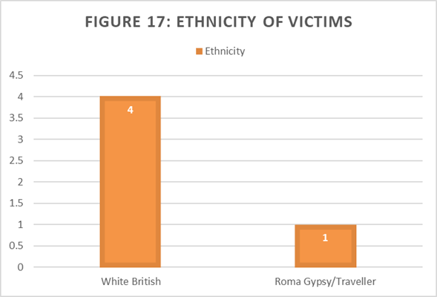
Looking at the ethnicity of victims, 4 out of the 5 victims were White British and 1 victim was of Roma Gypsy/Traveller background.

Slide 29
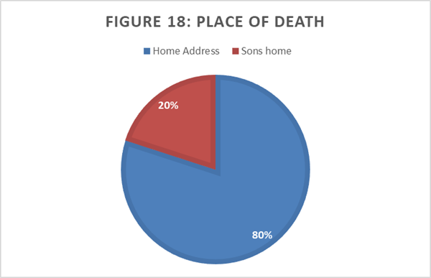
The home address of the victim was the most common location of death, with 80% (4 victims) dying at their home address.
1 victim died at their son’s home.

Slide 30
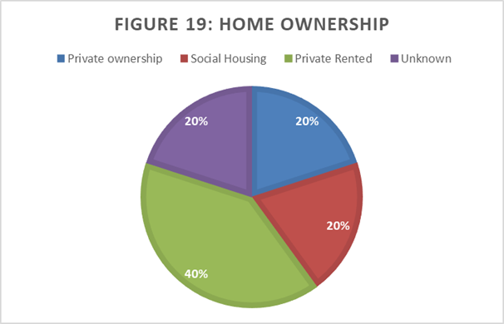
As we can see in Figure 19, 40% of victims (2 victims) lived in private rented accommodation.
1 victim lived in a privately owned home, 1 lived in social housing, and 1 had an unknown living situation.

Slide 31
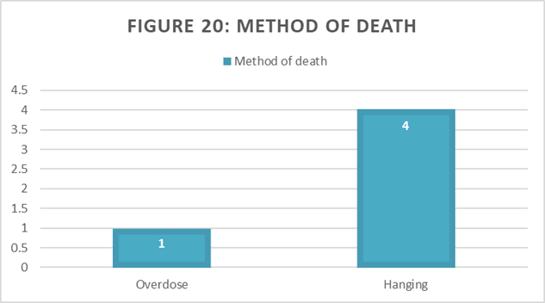
Looking at the method of death in cases of domestic abuse related suicides, hanging was the most common method of death, with 4/5 cases including this.
In the other 1 case, overdose was the method of death.

Slide 32
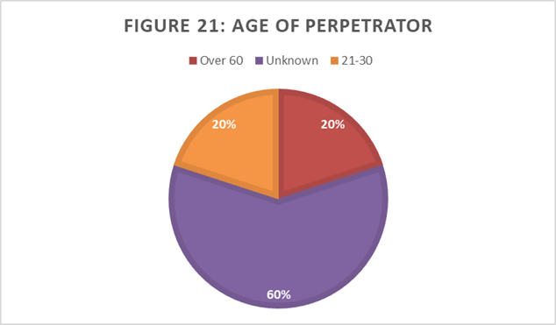
In 3/5 cases of domestic abuse related suicides, the age of the abusive partner was unknown.
In 1 case the perpetrator was over 60, and in 1 case the perpetrator was between 21-30 years old.

Slide 33
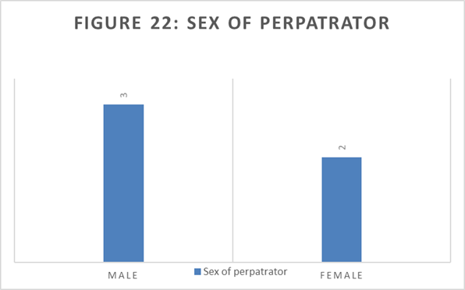
3 of the abusive partners were male and 2 were female. All were in heterosexual relationships.

Slide 34
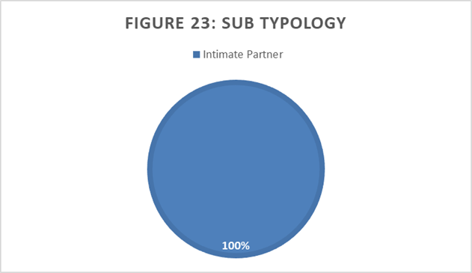
Sub typology refers to the specific ‘type’ of domestic abuse related suicide that has occurred.
In Cambridgeshire, all the domestic abuse related suicided come under the sub typology of intimate partners.

Slide 35
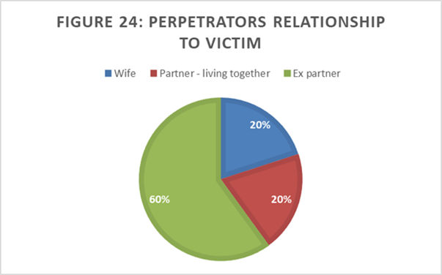
Of the 5 cases of domestic abuse related suicides, 3 abusive partners were the victims ex-partner.
One of the victim’s abusive partners was their wife, and one was their partner (living together).

Slide 36
Joint Statistics for both domestic homicides and domestic abuse related suicides:
In only 3 of the 20 DHRs were the victims known to specialist DA services, and all 3 were at MARAC (significant) level of harm. The other 17 cases were entirely unknown to specialist domestic abuse services.
In half - previous instances of domestic abuse (this includes the above case where the female perpetrator acted out of self-defence to an abusive partner).
20% of perpetrators were known to drug and alcohol services, and 15%were known to mental health services.
30% the perpetrator – alcohol misuse
20% the perpetrator – drug misuse

Slide 37
Themes within DHR recommendations
Of the 20 DHRs, 12 have been published, 6 are with the Home Office and 2 are in the progress of being written.
Across the 18 DHR Reports, there are 153 Recommendations

Slide 38
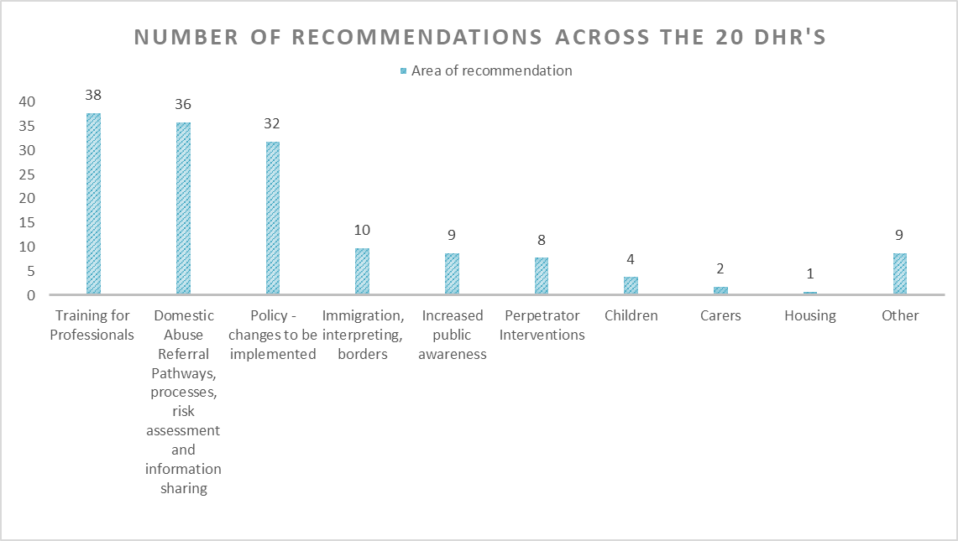

Slide 39
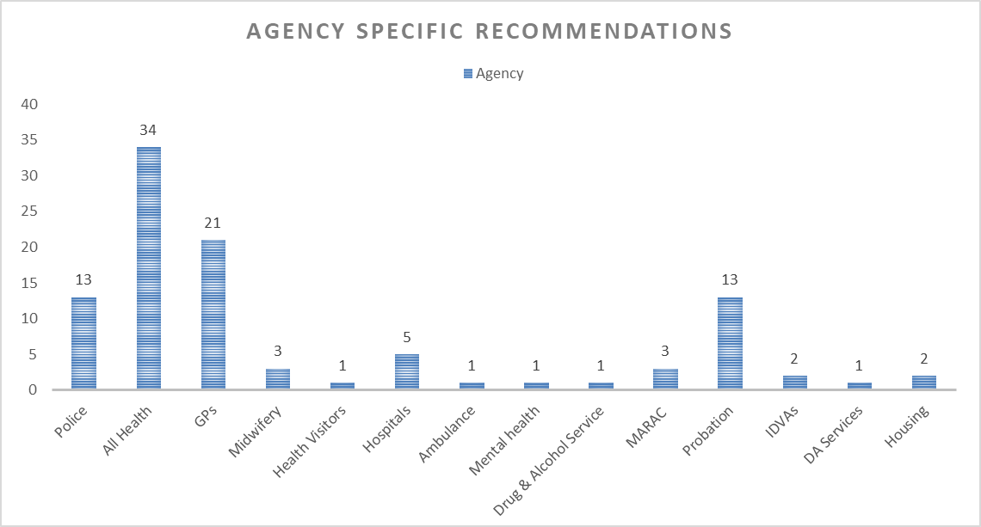

Slide 40
Outcomes of DHR’s in Cambridgeshire and Peterborough

Slide 41
Translation
There are now awareness materials in different languages, - now available on the www.cambsdasv.org.uk website and downloadable.
Having staff who can speak specific languages for a specific population, especially important in Peterborough where there is a large proportion of Lithuanian speakers, and a Lithuanian IDVA was employed to support this need.
The importance of independent translators and not using family or friends.

Slide 42
Minority Groups
Public awareness poster developed in partnership with Opoka – Polish domestic abuse support organisation
Posters in A8 languages available on website and shared with local organisations working with people from these countries
You Tube films in 7 languages – Urdu, Russian, Polish, Punjabi, Lithuanian, British Sign Language and English
DASV Champions session about Gypsy & Traveller victims delivered in by One Voice for Travellers

Slide 43
Professional Curiosity / Asking about DA
Particularly in health settings, being professionally curious, asking directly about domestic abuse was found to be very important.
Taking opportunities and making opportunities (seeing patients alone)

Slide 44
Training
Ensuring the front-line professionals have up to date training – for specific groups of professionals, such as the DASV Workforce, or drug and alcohol staff, or generic training.
Examples include coercive control and Clare’s Law in all basic DA training.
Specific workshops on coercive control.
Using DASV Champions sessions to upskill professionals re issues arising from DHRs – have included male victims, strangulation, suicide, substance misuse
Specialist training for the DASV Workforce – suicide prevention, working with male victims of DA
All drug and alcohol treatment staff have had sessions delivered regarding basic DA Awareness, coercive and controlling behaviour, working with perpetrators and DA Victims who misuse drugs and alcohol

Slide 45
Additions to the specialist DA Workforce
Male IDVA, Lithuanian IDVA and BAME IDVA
Team of Health IDVAs to work alongside health settings, taking referrals at all levels of need.
Specialist DA midwife at the Rosie Maternity Unit.

Slide 46
Older People
Development of a DASH Risk Assessment for older people, the first to be trialled in the UK.
Older People’s DASH Risk Assessment being piloted
Older People’s DA Guidance, based on Dewis Choice Project, developed and shared across all agencies
DA and Dementia guidance, based on Dewis Choice Project, being developed for presentations to DASV Champions and partner agencies

Slide 47
Male Victims
Male Victims IDVA
One Day Training from Respect for all Domestic Abuse specialist staff
Additional awareness raising including a poster aimed at male victims developed in conjunction with Respect, shared online and print versions distributed to all licensed venues across Cambridgeshire & Peterborough
DASV Champions session regarding male victims, delivered by Respect

Slide 48
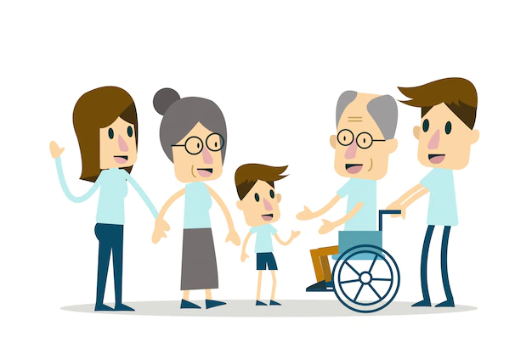
Carer’s
The DASV Partnership is working with the Carer’s Strategy Refresh project to ensure domestic abuse of, and by, family carers is included alongside multi-agency work and training in this area.

Slide 49
Health
The Clinical Commissioning Group are key members of every DHR panel and are responsible in supporting a range of health providers, in particular primary care to respond effectively to recommendations made from DHRs and to improve their response to domestic abuse. Activity includes:
The primary care newsletter has a spotlight on DHRs section. Each month information is shared which could be a lesson learnt or a suggested change in practice. This may reflect on trends or a precis of what a DHR is and their responsibility.
Drop-in sessions and GP Forums are regular sessions where domestic abuse issues to the attention of staff, and staff can bring issues to discuss.
Professional curiosity – there has been significant input into the significance of this and training has been delivered. There have been briefings, and this is spoken about widely – however, it continues to be a key issue.

Slide 50
Health (continued)
In working with GPs, CCG staff make suggestions for change but do not have the power to enforce implementation in practices.
Issues that are regularly considered are the recording of the name and relationship of anyone accompanying a patient and seeing patients alone.
The benefit of video calls when a face-to-face clinic is not possible where there is concern, over telephone calls.
Cross referring their safeguarding register with patients that regularly do not attend appointments as this has been a theme of some DHRs. We advise surgeries run a report on all patients that have missed 3 appointments in any 3 month period or less – to ensure they are contacted.

Slide 51
Conclusions
Across Cambridgeshire and Peterborough, the increase in the number of DHRs is likely to be a result of greater identification and information sharing, rather than a real increase in homicide or suicide, however, this cannot be proven.
The DHR process is to identify lessons or opportunities that the “system” and organisations could have responded more effectively to a situation of domestic abuse. The above outcomes were all driven by findings from DHRs.
The response following a DHR is rarely a “one off” activity, but a system or organisation adapting to improve outcomes for those who come after those who have died.
DHRs are complex. expensive, and time-consuming processes, making it vitally important that lessons are learned, and changes are made.
There will be more recommendations from the DHRs of those who died in this period once these reports and recommendations are complete.

