Slide 1
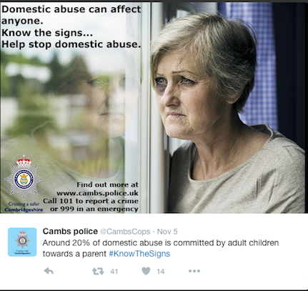
Safeguarding Adults & Domestic Abuse Champions
Understanding domestic abuse and safeguarding adults
Facilitator
Christine Jones – Safeguarding Adults Training and Development Manager, Cambridgeshire County Council
2023

Slide 2
Safeguarding Adults and Domestic Abuse -
Overall aim is to ensure professionals have a clearer understanding of domestic abuse and safeguarding adults and know how to safely respond.

Slide 3
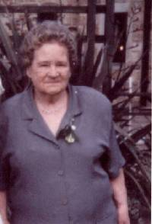
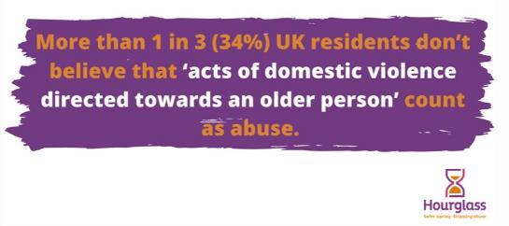
Opening Question
Using the chat box on MS Teams (highlighted in red):
Question: Do you recognise this adult and the relevance to domestic abuse?
2001 Hampshire SAB

Slide 4
Safeguarding is important because
Protection – for those who need it most
Proportionality – appropriate responses and good practice. Families and adults with care and support needs put their trust in you
Accountability - legal duties and responsibilities under the Care Act
Prevention – upholding your professional and organisational reputation (avoiding litigation and bad publicity
Collectively - it’s the right thing to do

Slide 5
Question
Using the chat box on MS Teams (highlighted in red):
Question: Under the Care Act 2014 local authorities are under a ‘duty’ to promote wellbeing when carrying out any care and support functions. What does wellbeing mean?

Slide 6
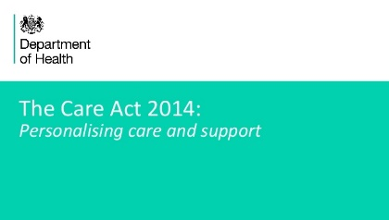
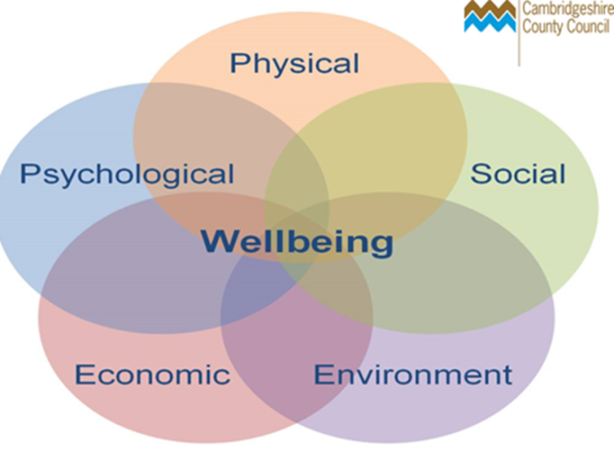
personal dignity
physical & mental health and emotional wellbeing
protection from abuse and neglect
control by the individual over day-to-day life
participation in work, education, training or recreation
social and economic wellbeing
domestic, family and personal wellbeing
suitability of accommodation
the individual’s contribution to society
The Statutory Guidance describes wellbeing as a broad concept and can include:
….None more important than the other
‘it is our fundamental duty to promote wellbeing in all that we do’ SCIE
Reflection: Consider how this works when working with domestic abuse?

Slide 7
Safeguarding Adults - ‘protecting an adult’s right to live in safety, free from abuse and neglect’
DoH&SC Care & Support Statutory Guidance S14.7
stop abuse or neglect wherever possible
prevent harm and reduce the risk of abuse or neglect to adults with care & support needs
safeguard adults in a way that supports them in making choices and having control about how they want to live
promote an approach that concentrates on improving life for the adults concerned
raise public awareness so that communities as a whole, alongside professionals, play their part in preventing, identifying & responding to abuse and neglect
provide information and support in accessible ways to help people understand the different types of abuse, how to stay safe and what to do to raise a concern about the safety or of an adult
address what has caused the abuse or neglect
DoH&SC Care and Support Statutory Guidance S14.11
Reflection: Consider how this works when working with domestic abuse and when completing a DASH/older people’s DASH?

Slide 8
Applies to all
sectors
6 Safeguarding Principles
Empowerment
Protection
Prevention
Proportionate responses
Partnership
Accountability
Human Rights underpin safeguarding practice – helps us to get the balance right between empowering individuals to be in control of their own lives, promoting their safety and the protection of others
Complements the 5 Guiding Principles of Trauma Informed Care:
Safety
Trustworthiness
Choice
Collaboration
Empowerment
Human Rights underpin safeguarding practice – helps us to get the balance right between empowering individuals to be in control of their own lives, promoting their safety and the protection of others

Slide 9
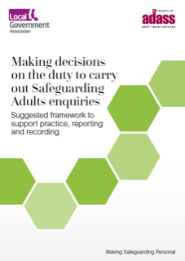
Making Safeguarding Personal….
‘…engages the person in a conversation about how best to respond to their safeguarding situation’
DoH&SC Care& Support Statutory Guidance 2020
What difference is wanted or desired by the adult?
How can you and others facilitate or enable that difference? Consider advocacy
How will the adult know that a difference has been achieved?
…use your professional curiosity and judgement – consider the ‘lived experience’
Are you culturally competent/aware?
Reflection: Consider how this works when working with domestic abuse?

Slide 10
Consider: Care Act s68.3 (Safeguarding Enquiries/SAR’s)
(3)The condition is that the local authority considers that, were an independent advocate not to be available, the individual would experience substantial difficulty in doing one or more of the following—
(a)understanding relevant information;
(b)retaining that information;
(c)using or weighing that information as part of the process of being involved;
(d)communicating the individual’s views, wishes or feelings (whether by talking, using sign language or any other means)*.
*NEW Interpreting and translation guidance
What does this remind you of?
Be aware of the current trauma cards pilot

Slide 11
Adult with care and support needs
Vulnerable Adult
Who may be an adult with care and support needs?

Slide 12
An adult with care and support needs:
This may be a person who:
is elderly and frail due to ill health, physical disability or cognitive impairment
has a learning disability
has a physical disability and/or a sensory impairment
has mental health needs including dementia or a personality disorder
has a long-term illness/condition
misuses substances or alcohol
Who is an ‘Adult at Risk’ (as per the Care Act)?
How many adults with care and support needs do you have in your service?

Slide 13
As per the Care Act, an adult at Risk is:
14.2 The safeguarding duties apply to an adult who:
Has needs for care and support (whether or not the local authority is meeting of any those needs) and
Is experiencing , or at risk of, abuse or neglect; and
As a result of those care and support needs is unable to protect themselves from either risk of, or the experience of abuse or neglect. The Care Act 2014 S42.1
Just a guide!
Contact your manager for advice and support (may need to consider Multi Agency Risk Management procedures)
Check - Reg 18 and/or NOCC?

Slide 14
Checking your understanding…
Which scenario would most likely trigger a S42 enquiry?
A man with a physical disability falls prey to an online scam
A student with depression hits her mother
A woman with a learning disability is tricked out of her inheritance by her brother

Slide 15
Types of Abuse H&SC Care & Support Statutory Guidance S.14.17
Physical abuse
Sexual abuse
Psychological abuse
Financial or material abuse
Discriminatory abuse
Neglect or acts of omission
Organisational abuse
Domestic abuse*
Self-neglect*
Modern slavery
Does the Care & Support guidance give a definition of abuse?
….not limited by what constitutes abuse’ DOH&SC Support and Statutory Guidance 2015
S42 of the Care Act does not define what constitutes an enquiry, but requires the Local Authority to “……make (or cause to be made) whatever enquiries it thinks necessary to enable it to decide whether any action should be taken in the adult’s case………” ADASS conference 2019

Slide 16
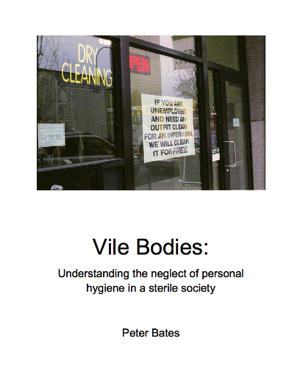
- covers a wide range of behaviour neglecting to care for one’s personal hygiene, health or surroundings and includes behaviours such as hoarding
Self Neglect
‘It should be noted that self-neglect may not prompt a section 42 enquiry. An assessment should be made on a case by case basis. A decision on whether a response is required under safeguarding will depend on the adult’s ability to protect themselves by controlling their own behaviour. There may come a point when they are no longer able to do this, without external support.’ Care Act 2014 – Update 24th March 2016
Go to the Cambridgeshire and Peterborough Safeguarding Adults Board website for specialist advice and guidance regarding self neglect and hoarding behaviours
www.peterbates.org.uk

Slide 17
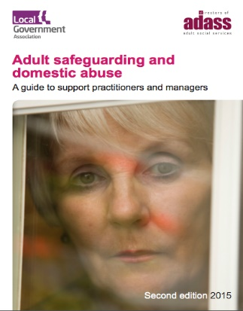
Long definition – Part 1 - ‘Behaviour of a person (‘A’) towards another person (‘B’) is ‘domestic abuse’ if (a) A and B are each aged 16 or over and are personally connected to each other and (b) the behaviour is abusive’
Definition includes single incident, economic abuse
Outlaws ‘rough sex’ offence
Children also recognised as victims
Acknowledges the Care Act and adults with care and support needs (P39 – 40, s153-158)
Collaborative approach – domestic abuse protocols and safeguarding adults protocols apply
Adult social workers need regular updated domestic abuse training
Safeguarding Adults Boards need to manage MARAC and domestic abuse data eg DHR’s (which may also involve SAR’s)
Domestic Abuse Act 2021

Slide 18
It may be that a relationship has always experienced some DA, but what has changed is the health or ability of the ‘victim’ meaning they can no longer protect themselves. In other cases, the ‘victim’ may be put in the position of caring for the ‘perpetrator’ after a stroke or some illness debilitates them. They may not be able or willing to provide the best care and the partner/adult may be at risk of abuse.
Therefore, with safeguarding adults, we MUST consider the ‘caring’ relationship (10 DHR’s involving the carer relationship in Cambridgeshire since 2018)
Consider – how does this statement relates to adults with care and support needs?

Slide 19
Be aware that Domestic abuse can co-exist with Dementia
Harmer living with dementia
Both victim and survivor living with dementia (tactics from the harmer may be exacerbated, victim may not be able to use their ‘usual’ survival tactics)
Victim-survivor living with dementia
The individual can experience harm from an informal/unpaid carer (and vice versa)

Slide 20
A recent report from The Disabilities Trust (2019) highlights:-
over half of women who have sustained a permanent brain injury, this was caused by domestic abuse – a staggering 62%.
61% of women with a brain injury caused by domestic violence have self-harmed.
35% of these women have not sought help for their brain injury
a large number of these women will have been prevented from seeking treatment by the abuser.
Highlights importance to consider the MCA when supporting decision-making
https://www.thedtgroup.org/the-disabilities-trust-news-and-media/news/the-disabilities-trust-continues-to-highlight-the-link-between-brain-injuries-and-domestic-abuse
Womens Aid Audit 2023 – Over a quarter of survivors (28.7%) reported having a disability (56% mental health 22.3% physical health disability) womensaid.org.uk
‘Abi’-left permanently disabled after her attack
Coercive control, capacity and the resolution of an ethical dilemma – Mental Capacity Law and Policy

Slide 21
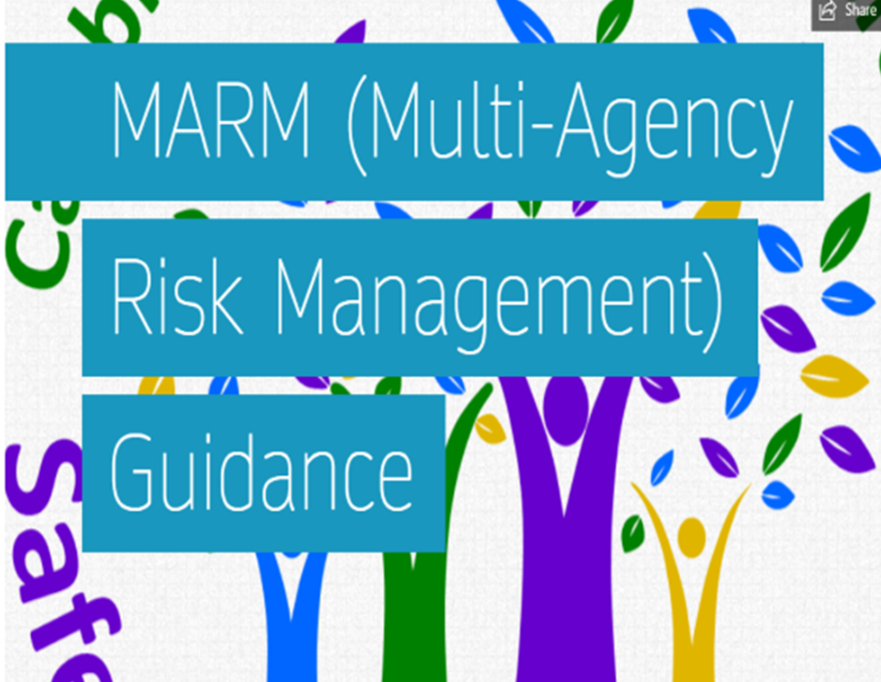
MARM – Multi Agency Risk Management procedure
Introduced in 2019
Aimed at individuals who have care and support needs, have mental capacity and are not engaging with services.
Provides professionals from all agencies with a framework to facilitate effective multi-agency working with adults (aged 18+) at risk of harm who are deemed to have mental capacity for specific decisions that may result in serious harm/death through severe self-neglect or risk-taking behaviours and refuses or is unable to engage with services.
Provides a structure for professionals to come together and discuss how best they can support an individual who does not want the support of agencies.
Reflection: ‘choosing’ to constantly living with high risk – is that a form of self-neglect?

Slide 22
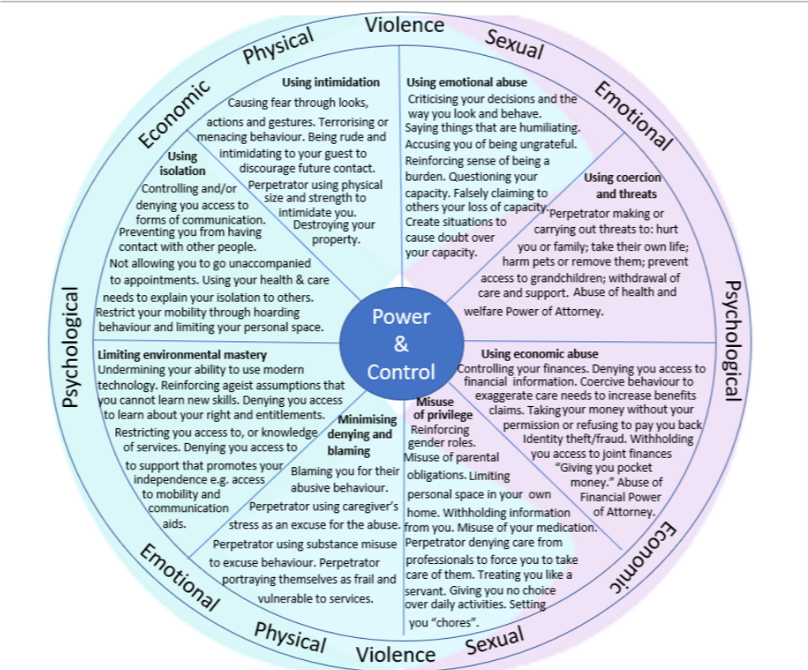
Duluth Wheel adapted for Adults with Care and Support Needs (Dewis Choice)
- Tactics where the carer is perpetrating the abuse…

Slide 23
Refusing to support the person’s independence, creating increased dependency on the carer
Exaggerating the person’s mobility or health concerns to explain why they are not engaging socially
Exaggerating the person’s care need’s to practitioner’s, other family members and friends
Denying access to mobility, hearing and visual aids
Telling others the person lacks capacity to make decisions for themselves
Threatening to withdraw care if the adult does not comply
Refusing transport, or allowing others to transport to attend appointments/social activities/visit friends
Taking control of a person’s means to make contact with friends/services eg no access/not allowed to answer phone, opening post, denying access to digital technology
Consider - Technology-related abuse and domestic abuse
Be mindful:
There may be no visible physical signs, particularly abuse which is psychological/emotional and controlling in nature which can include:
Now also need to be mindful of the signs when the informal carer is the victim

Slide 24
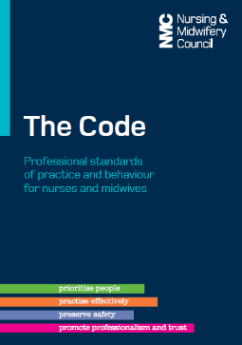
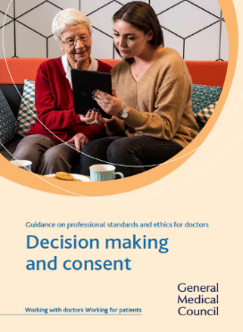
Before thinking Care Act – think consent
Consent is mentioned 75 times in the DoH Care and Support Statutory Guidance.
The basic rule is simple: no-one has the right to force someone to do something without lawful excuse.
There are three components to valid consent:
The person must have sufficient information to make a choice
The person must be able to give their consent freely
The person must be competent

Slide 25
Sharing confidential information – Human Rights
Under Article 8, individuals have a right to respect for private and family life
This is not an absolute right and can be overridden if necessary and in accordance with the law
Interference must be justified and for a particular purpose especially if your adult is not consenting or you think there is coercive controlling behavior/minimising the behaviour

Slide 26
Care Act 2014 - duty to safeguard and protect (S14.158 Care & Support Statutory Guidance)
The Data Protection Act 2018
WELLBEING
‘What good is it making someone safer if it merely makes them miserable?’
Lord Justice Munby ‘What price is dignity?’ 2010
If a person doesn’t want information to be passed on, you must consider:
are other people at risk?
if it is a domestic abuse concern are there children or other adults at risk involved?
do you suspect a serious crime has been committed?
are staff implicated?
is coercion/duress involved?
Consent needs to be informed and voluntary
Enabling a person to manage their own risk, in the way that they wish, is better than trying to remove risk inappropriately
How knowledgeable are you when it comes to the GDPR and safeguarding adults?

Slide 27
Schedule 1 Part 2 Data Protection Act 2018 – 23 substantial public interest conditions
….protecting an individual from neglect or physical, mental or emotional harm or
….protecting the physical, mental or emotional wellbeing of an individual (may involve an unpaid carer)
GDPR
Consent
Vital interests – processing is necessary…..
Public task – your official authority
Legal request (from police/coroner) , legal requirement or other statutory powers (eg under Mental Health Act)
Additional Legalese

Slide 28
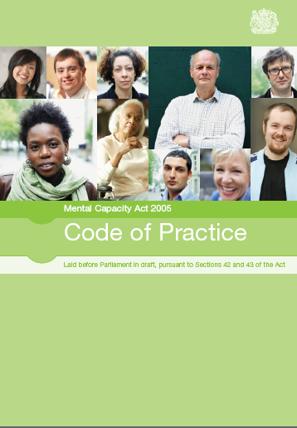
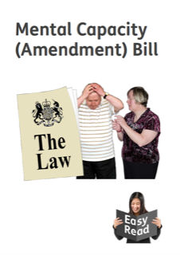
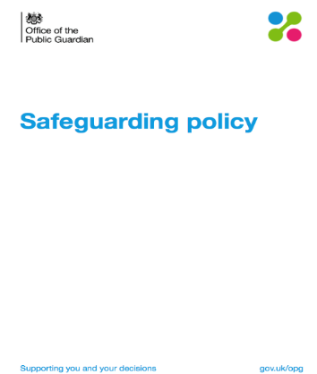
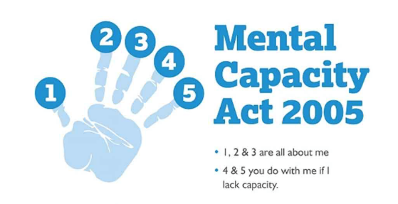
Mental Capacity Act 2005
Code of Practice –
S2.11 - There may be cause for concern if somebody:
repeatedly makes unwise decisions that put them at significant risk of harm or exploitation or
makes a particular unwise decision that is obviously irrational or out of character.
Anyone acting in professional role
Anyone with legal authority to make decisions on behalf of person lacking capacity
Anyone paid for acts in relation to a person who lacks capacity.
Guide for family carers
Main Aspects to this Act - Principles - IMCA’s - LPA’s - DoLS (?LPS’s) - Section 44

Slide 29
Sharing Confidential Information
The Human Rights Act 1998 (A2, A3, A5, A8, A14)
The Data Protection Act/GDPR 2018
Care Act 2014 - duty to safeguard and protect (S14.158) – (S81) Duty of Candour
Section 115 of the Crime and Disorder Act 1998 - power to disclose to the police
The common law duty of confidentiality – duty of care
7 principles laid out by the Caldicott Judgement
Key legislation

Slide 30
Sharing information without consent
‘…80% SAR’s…. agencies and professionals did not ‘work together’ and in 70% of SARs, practitioners did not ‘share information’ s4.5 C&P SAB Thematic Review 2020
Remember:
Always try to gain consent – try to find out why they don’t want to share, explain the advantages and what help might be available
Reassure them that as far as possible they will remain in control of decision making
Unless it increases risk – always tell the person if you need to share their information and why
DASH/older people’s DASH

Slide 31
A crisis plan sits within any safety plan
Has to be the person’s own plan
MUST complement the care and support plan (or s42 support plan)
May include staying with the partner, leaving in an emergency and/or after separation – crisis, tracking & tech abuse, keeping records, telling somebody, copies, know your rights, specialist support
Are there any community resources that may be helpful to include? Eg Managed Reciprocals (currently coordinated by the IDVA service as vital a DA specialist assesses the risks)
Crisis and safety planning templates
Safety Planning

Slide 32
Making assumptions - ie injuries must be due to falls because of old age or disability or that the adult with the care and support need is unable to perpetrate abuse
Can’t happen in a Residential Home setting
Justifying or putting DA down to carer stress and not linking to issues like theft to DA
Family abuse more prevalent than IPV, sometimes more than one perpetrator
80% older victims don’t seek support
Femicide census 2009-2015 - 16% of victims were aged 66+
DHR’s involving older people – professionals not recognising coercive control
Analysis of 131 cases in Wales showed best outcomes for OP victims when DASH/MARAC involved and joint working - IDVA and ASC
Source:- C&P VAWG newsletter 2020/21
Key points for professionals…..

Slide 33
Finally….
The topics we have discussed have included:
The definition of domestic abuse
The overlap with safeguarding adults
Exploring the dynamics and effects of an abusive relationship and how professionals can unwittingly collude
Consent and domestic abuse
Any further questions? Please e-mail me directly Christine.jones@cambridgeshire.gov.uk

